Slide 1
Handle Case Management Workshop A-2 Jose Diaz and Mohanta Das 6/24/26

Slide 2





Overarching Design Principles
The goal of this project is to utilize standard Service Cloud V2 capabilities with minimal customizations. We will strive to modify our processes to Fit-to-Standard SAP technology as much as possible.
SAP First
We will adopt an “SAP first” strategy with all financial and operational data housed within SAP.
Fit to Standard
Rationalize Applications
We will change and adapt our existing business processes to fit to standard ‘out of the box’ functionality.
We will standardize and rationalize our applications to control costs and reduce the complexity of our IT estate.
Minimize customizations
‘Best of Breed’ by exception
Non-SAP applications will only be considered if they are considered ‘best of breed’ and are necessary to enable competitive advantage or meet complex regulatory requirements.
We will minimize customizations and keep the core clean to ease future upgrades, improving agility and scalability.

Slide 3
Workshop Agenda
TOPIC
01
Scope, Purpose, Objective
Deeper Dive into Case Management (Case Resolution, Case Schema, etc.)
(L3) Process High Bill Inquiry
BREAK – 10 Mins
FRICE-W
Drafted User Stories
Small Group Breakout – What Chanels are going to move to Case Management (continued follow up session)
02
03
04
05
06
Notes:
Need to go through the remainder of Dawn's list for item 6 + Melissa's Fraud/Theft/Estates request.

Slide 4
01 Scope, Purpose, Objective

Slide 5
Scope, Purpose, Objectives
Scope
Purpose
Objective
Scope of this document covers the to-be state for the Handle Case Management processes between SAP Service Cloud v2 and SAP S4HANAer
Describe the process of Handle Case Management
Offer a holistic view of all the key elements of the to-be process including organization/roles, configuration or customization if needed, data, reporting, security, and controls requirements.
Define the target-state ownership and L3 processes.
Document key assumptions/decisions and outline any FRICE-W's and reports.

Slide 6
Ownership
Workshop/PDD | Level 1 | Level 2 | Level 3 | Teams Impacted | Business Process Owner | Reviewer
20.0 A-1 Handle Case Management | Manage Customer Service | Handle Case Management | 20.1 Manage Cases | Customer | Stephanie Koczenasz, Melissa Howe | Customer Core Team
 |  |  | 20.2 Process High Bill Inquiry | Customer, Finance | Stephanie Koczenasz, Melissa Howe | Customer Core Team
WORKSHOP FACILITATION
Facilitator: Jose Diaz, Mohanta Das
IBM Scribe: Taylor Ilov
Change Impacts: Julie Vandblarcum, Olivia Shen
CE PARTICIPANTS
Global Process Owner: Stephanie Koczenasz, Melissa Howe
SMEs

Slide 7
02 Deeper Dive into Case Management (Case Resolution, Case Schema, etc.)

Slide 8
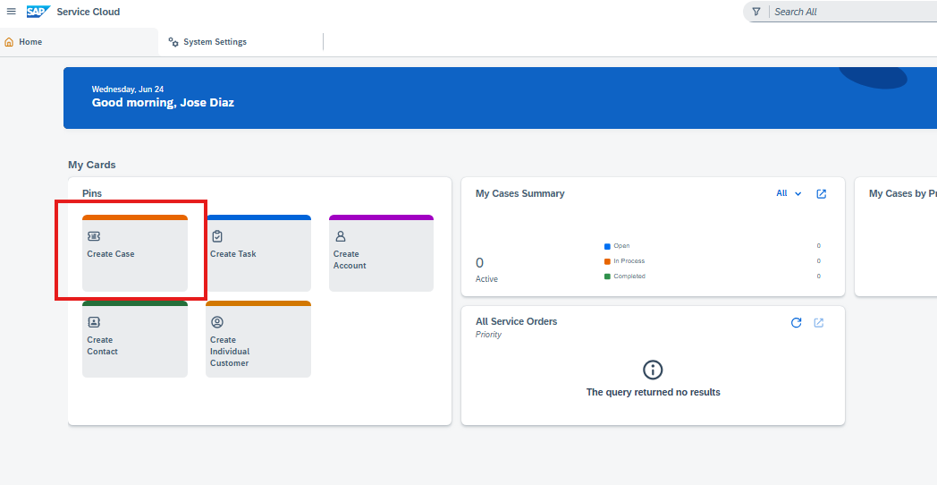
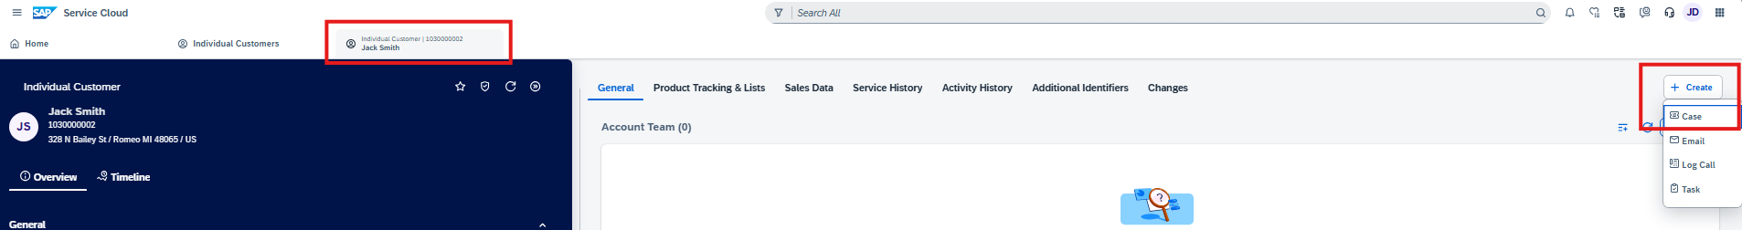
Where Can I Create A Case In Service Cloud v2?
Users can create a case from the home page under My Cards -> Pins
Users can create a case from the individual customer screen under the Create Action

Slide 9
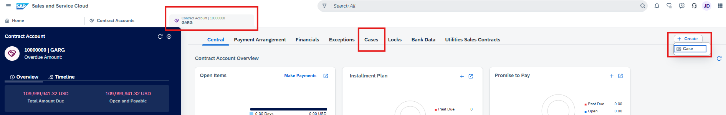
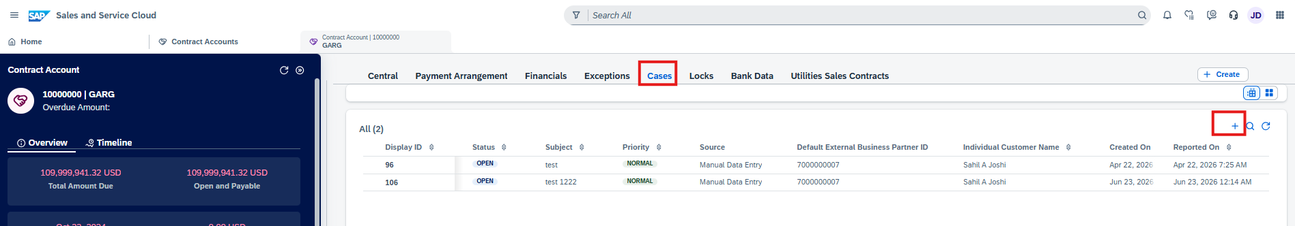
Where Can I Create A Case In Service Cloud v2?
Cases can be created through the contract account

Slide 10
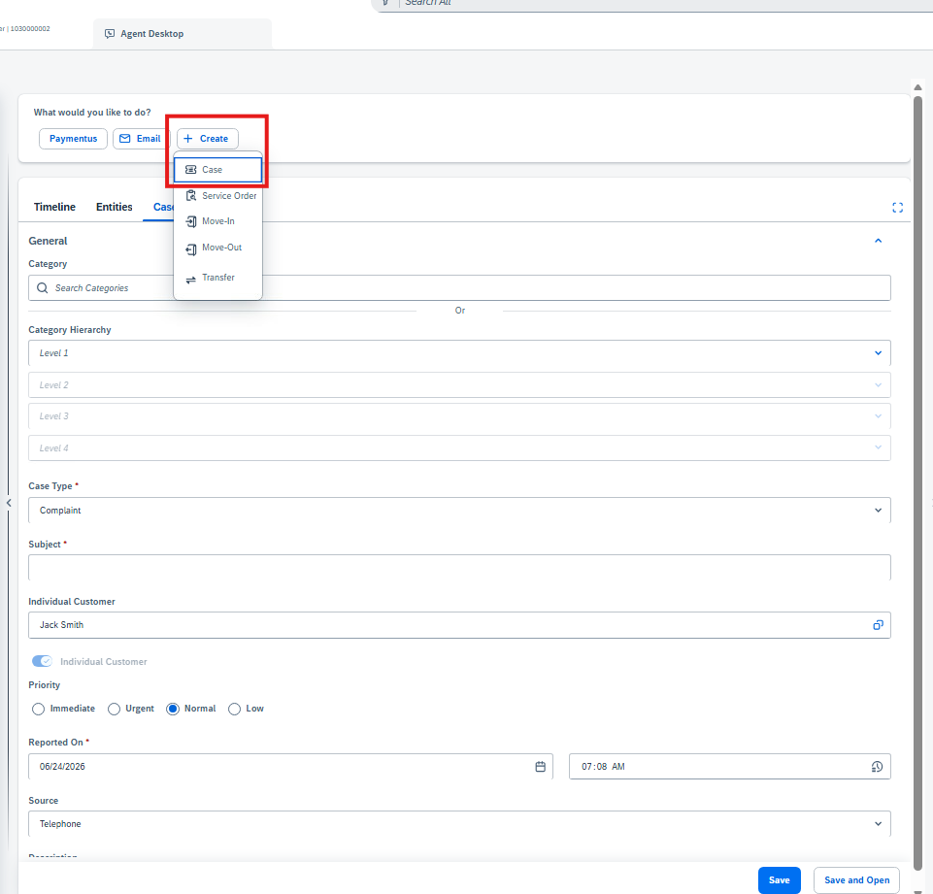
Where Can I Create A Case In Service Cloud v2?
Users can create a case through the Agent Desktop
Users can create a case through the Premise

Slide 11
Status Schema
Status schemas can be configured based on business needs. Each Case Type can have its own Status Schema. Once a case is closed, the system will not allow a change to the status
Status Code | Status | Reachable Status | Non-Reachable Status
01 | Open | In Process Customer Action Completed | Closed
02 | In Process | Customer Action Completed | Open Closed
04 | Customer Action | In Process Completed | Open Closed
05 | Completed | In Process Customer Action Closed | Open
06 | Closed | N/A | Open Closed Customer Action Completed

Slide 12
Process Flow Example
The case process flow consists of phases and steps. These steps guide the CSR / Agent visually through processing the case and providing next best steps.
Collect Info
Customer
Research
Search KB Articles
Resolve
Email customer or group
Product
Issue
Check Alerts
Ask experts or colleagues
Add attachment
Types of steps that can be added include:
To Do tasks or actions
Autoflows
Approvals
Mashup
Feedback
Input
Assignment
Phases
Steps

Slide 13
Service Level Agreement
Service levels are based on target milestones with response times, and specifying working hours and time zones. SLA’s can be configured based on various attributes (i.e., Complaint SLA is different from a Fraud SLA)
Milestones
Due Date for Initial Review
Due Date for Response
Due Date for Resolution
Due Date for Completion
Example: a CSR/Agent works Monday – Friday, 8:00 AM EST to 17:00 PM EST
A Case is created on Wednesday June 24th 12:PM EST.
If initial review is configured to be “2 days”, then the Initial Review Date would be on Friday, June 26 12:00 PM

Slide 14
03 High Bill Inquiry

Slide 15
BREAK! - 10 mins

Slide 16
04 FRICE-W

Slide 17
FRICE-W Identified
Case Summary Notice
Case Field Enhancements (i.e., show service order id, notification id on the case)
Fetch relevant details from ECC to create the notification
Generate event for Notification creation in S/4HANA
Notes:
Need to include another wricef around notes prepopulating

Slide 18
05 Drafted User Stories

Slide 19
User Stories for Handle Case Management
Please note, this is just a drafted starting point we will leverage to formulate our actual user stories and acceptance criteria
L1 | L2 | L3 | L4 | User Story | Acceptance Criteria
Manage Customer Service | Handle Case Management | Create Case | Create Case | As an SAP Customer Service Representative, I want to create cases within the Manage Customer Service case management area to capture customer issues efficiently and enable proper tracking and resolution. | 1. Able to enter customer issue details while creating the case. 3.Able to set the initial case status during creation. 4.Able to assign case priority at the time of creation. 5.Able to select case category when creating the case. 6.Able to link the case to the relevant customer record. 7.Able to save the newly created case successfully. 8.Able to add initial case notes during case creation. 9.Able to build Security roles and perform testing. 10.Able to identify Risk and Controls
Manage Customer Service | Handle Case Management | Modify Case | Modify Case | As an SAP Customer Service Agent, I want to modify case records within Handle Case Management so that I can update case information accurately during the Manage Customer Service process. | 1. Able to open an existing case for modification. 3.Able to enter edit mode for the case. 4.Able to update case information. 5.Able to save the modified case. 6.Able to cancel the modification. 7.Able to verify the case reflects modifications. 8.Able to exit modification and return to case view. 9.Able to build Security roles and perform testing. 10.Able to identify Risk and Controls
Manage Customer Service | Handle Case Management | Route Case | Route Case | As an SAP Customer Service Agent, I want to route cases within Handle Case Management to ensure timely assignment and resolution aligned with Manage Customer Service processes. | 1. Able to select a routing destination for the case. 3.Able to route the case to the chosen destination. 4.Able to re-route the case when needed. 5.Able to validate the routing before confirmation. 6.Able to view the current routing status of the case. 7.Able to record routing history for the case. 8.Able to cancel a pending routing action. 9.Able to build Security roles and perform testing. 10.Able to identify Risk and Controls

Slide 20
06 Small Group Breakout

Slide 21
Small Group Breakout
Continue through Dawn's list of what channels will be used in Case Management
+ Fraud/Theft/Estates demo request from Melissa

Slide 22
Program Charging (CE Internal Only)
The Change & Why:
We need to track O&M costs more precisely. OCM and Data Conversion must be charged separately from End User Training and from Design/Build/Deployment work. This change is retroactive from February for Accounting, Rate case discovery, and audit.
Ask:
Pls follow the instructions below that apply to you based on your staffing category on the LaunchPad program. It is critical to track costs in the correct cost buckets.
Business Partner (BP) Core Team (Use SAP*):
Continue 100% allocation as before. (BP&A handles this automatically behind the scenes and no time entry is needed except for the two scenarios below)
Submit time only for OCM and Data Conversion activities; Use SAP to bill IO 6520973.
Submit time only for End User Training; Use SAP to bill IO 6519532.
IT Core Team (Use Clarity):
S4- Customer – Design/Development/Testing/Deploy Clarity Task
Clarity Timesheets will now be used for time charging, and the allocation mechanism is discontinued. Submit timesheets from February 2nd for a one-time catchup.
Separate tasks for OCM, End User Training, and Data Conversion are available; Find them using keywords OCM, End User Training, and Data Conversion and charge them as applicable.
Extended BP Team (use SAP*):
Bill SAP IO 6520973 for OCM and Data Conversion.
Bill SAP IO 6519532 for End User Training.
Use new IO 6521411 for all other tasks.
Extended IT Team (Use Clarity):
S4- Customer – Design/Development/Testing/Deploy Clarity Task
Bill specific tasks for OCM, End User Training, and Data Conversion; ID the tasks using the keywords OCM, End User Training, and Data Conversion.
Bill other tasks as appropriate.
*SAP Timesheet Submission Instructions (for BPs)
Follow ESS steps (screen shot below): 1. Open ESS timesheet. 2. Enter IO number in work order field. 3. Select WORK code under ATT-ABS. 4. Add OCM, End User Training, or Data Conversion in comments. 5. Enter hours worked.

Slide 23
What is Case Management?
Case Management serves as a front office service container where agents/CSRs can track interactions with the service requestor. A case is a request for some type of service or support from an account, customer, or contact person. Cases provide the agents/CSRs to:
Intake the request or complaint
Capture guided information
Track interactions
Collaborate and manage the resolution
Cases can record details like how much time has passed since the case was created, what actions were taken to resolve the issue, priority, associated equipment impacted, etc. Cases can orchestrate downstream utility actions like creating a service notification, service order, etc. if necessary.
1. Incoming Request
2. Multiple Channels
3. Case Created
4. Manage & Collaborate
5. Resolution & Customer Service
?
Social Media
Collaboration
Work together across teams
Social Media
CASE
Knowledge Base
Email
Find answers & shares knowledge
Customer Reaches out through any channel
Web ./ Portal
ML / AI
Issued resolved and customer satisfied
Mobile App
Find similar cases
Case Summary
Case Triage & Assignment
SLA & Escalation Management
Integrations & Actions (as needed)
Route to right expert/team
Field/Back Office Execution
Monitor response and resolution targets, trigger alerts, and escalate at-risk cases
Service Notification
Notifications, Work Orders
Monitoring & Status
Service Order / Service Request / Field Service
Track Progress
Alerts
Escalations
SLA Targets
External Systems / Workflows

Slide 24
What Actions A Case Can Do
Case
Generate Email
Generate Service Request
Trigger Events to 3rd Party
Generate EMMA Case
Trigger Events to S/4HANA
Generate Service Notifications
Cases can perform multiple actions based on the business case. For example,
Damage Claim Case gets created:

Slide 25
Scope of Case Management
Today Consumers utilizes the front office order management to create service notifications. Service Notifications is used to log and track maintenance and service requests. Some service notifications turn into service orders based on the notification type and the configuration settings. For example, a complaint does not turn into a service order, but a D2 – Gas Meter request will create an order. In the future state, Consumers will utilize case management in the front office to record requests, assist in resolution, and track progress. Cases can be maintained directly in Service Cloud v2 or trigger the creation of a service notification in S4HANA to maintain current procedures for the near future.
Consumers heavily utilizes Service Notifications that is maintained in the Plant Maintenance and Customer Service function in SAP ECC. SAP plans to sunset this functionality by 2030. SAP Service Cloud v2 is AGNOSTIC to the future state decision as to what component will replace service notifications. If required, cases can trigger events to SAP S/4HANA.
Current State
CRM7 Order Management
CRM7 Middleware / RFC
Service Notification Created
Service Order then created if required
Future State
Service Cloud v2 Case Management
BTP Integration Suite
Notification / Order / Service Request (as required)

Slide 26
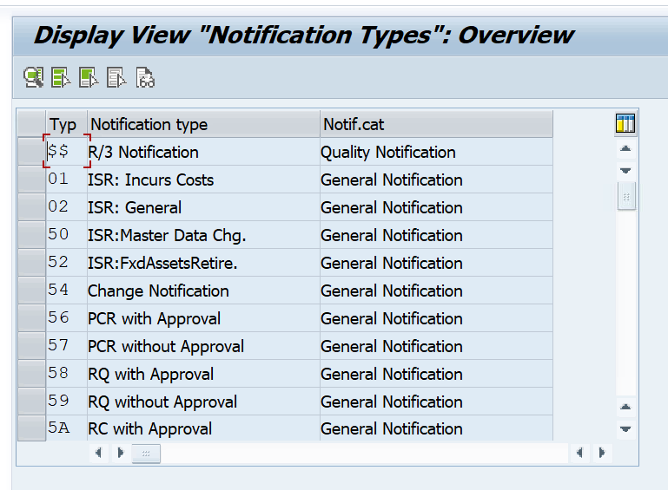
Service Notification’s Maintained
Today, ECC has 88 Notification Types configured. Each notification type is assigned a notification category.
10 are Quality Notification Types
32 are Service Notifications Types
25 are Maintenance Notifications
21 are General Notifications
Notification Types can also be assigned a catalog profile and a number range
No | From No | To No | NR Status | Ext
01 | 001000000000 | 009999999999
02 | 000600000000 | 000699999999
03 | 000200000000 | 000299999999
Notification Types that only remain as notifications (NOT FINAL)
Type | Notification Description | Catalog Profile | NR
V2 | Customer Operations | NO_V2 | 01
V5 | Claims | NO_V5 | 01
P6 | OMS/Emergency | NO_P6 | 01 | ??
Full list of Notification Types found here: Handle Case Management

Slide 27
02.1 (L3) Create Cases

Slide 28
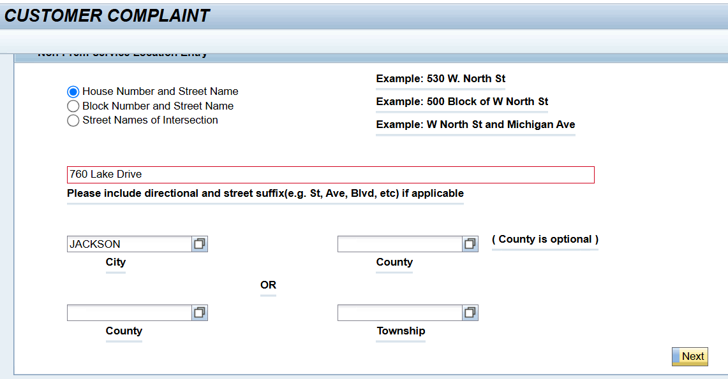
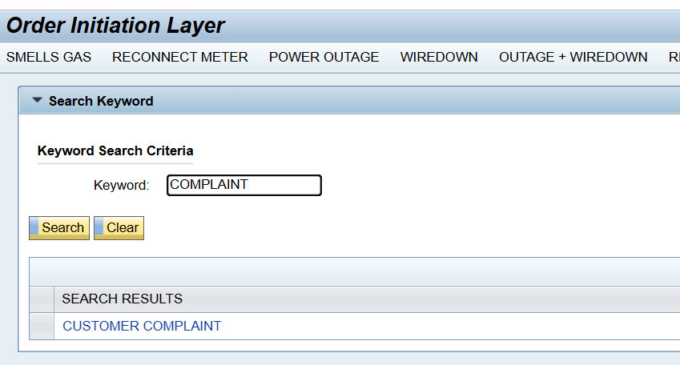
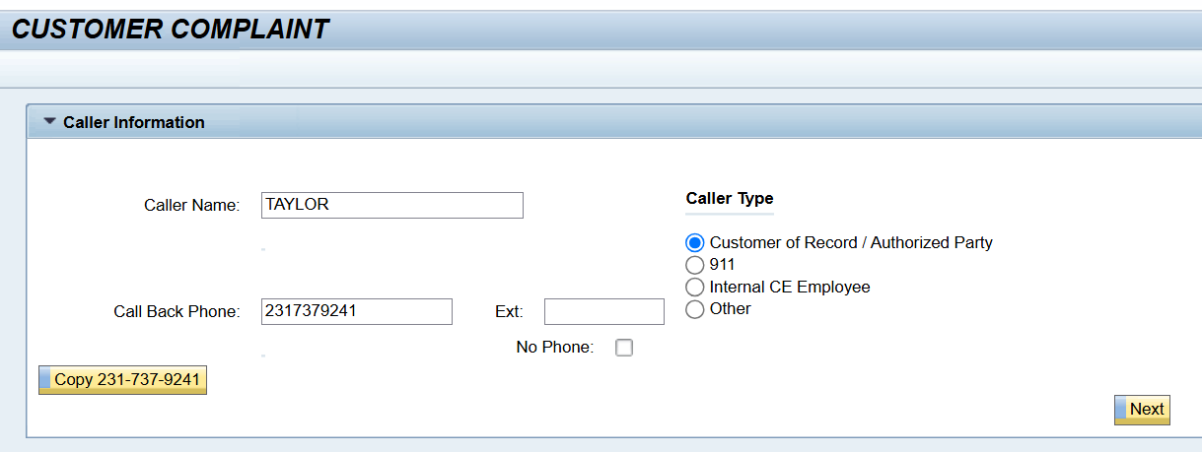
Create Notification in CRM7
1
3
2

Slide 29
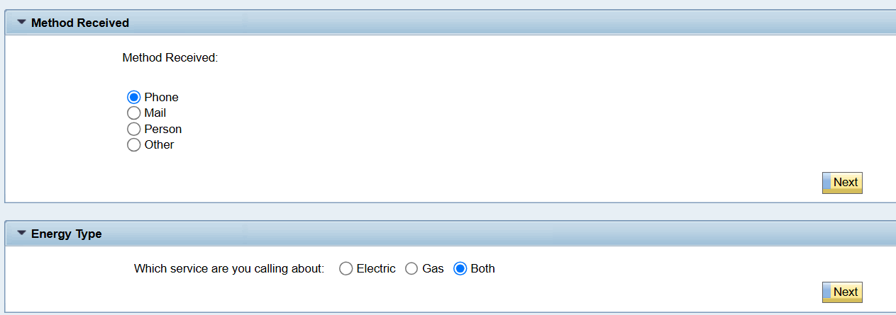
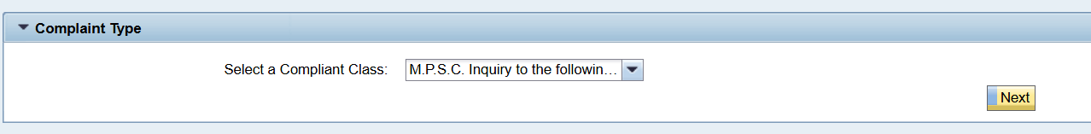
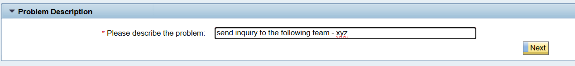
Create Notification in CRM7
4
Complaint Types that are service notifications:
Billing
We Care
Corporate
E.C.A.C.
M.P.S.C. Inquiry to the following group
Legislative
M.P.S.C.
Other
5
6
7

Slide 30
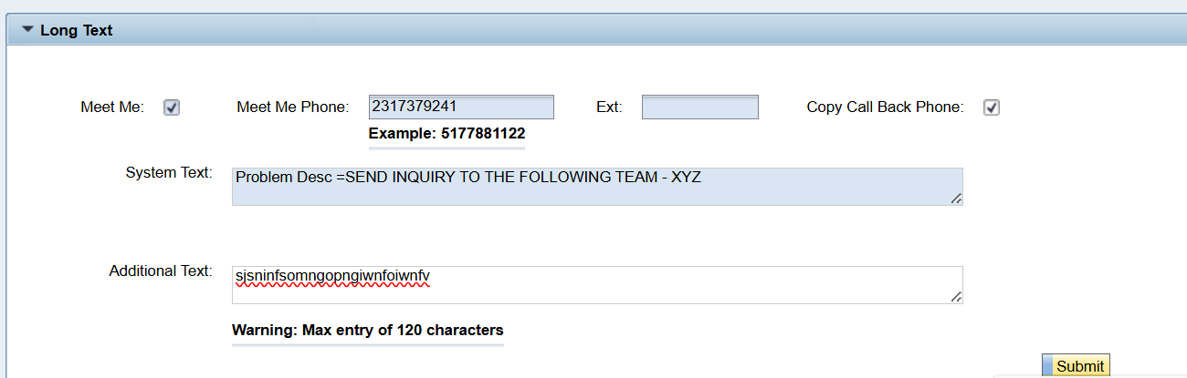
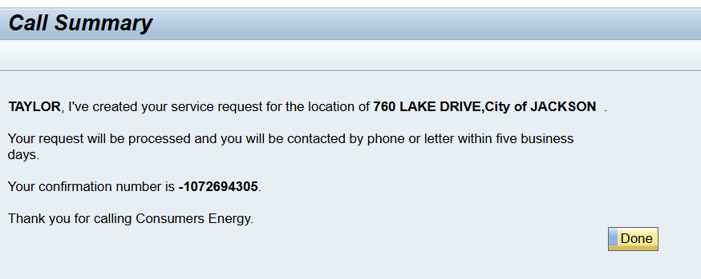
Create Notification in CRM7
7
8

Slide 31
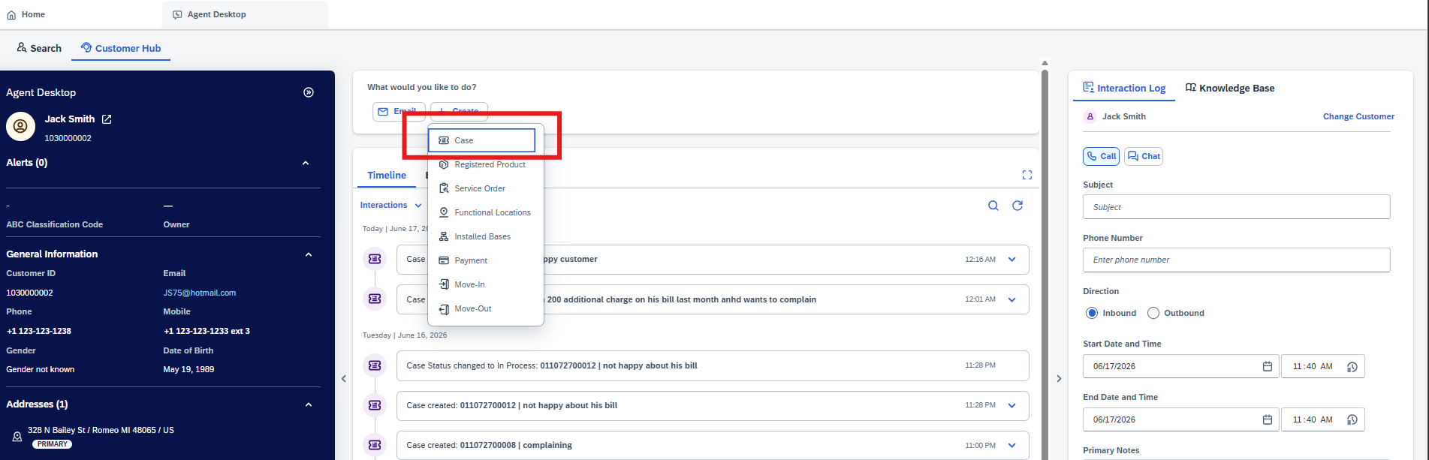
Create Case in Service Cloud v2

Slide 32
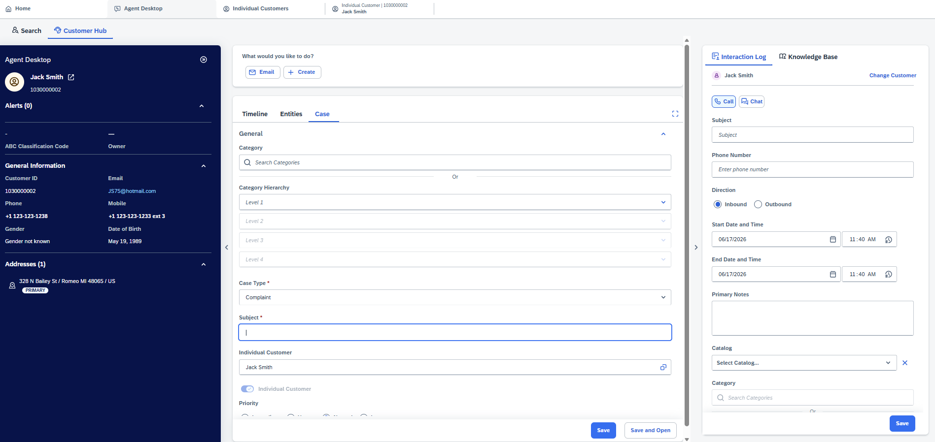
Create Case in Service Cloud v2

Slide 33
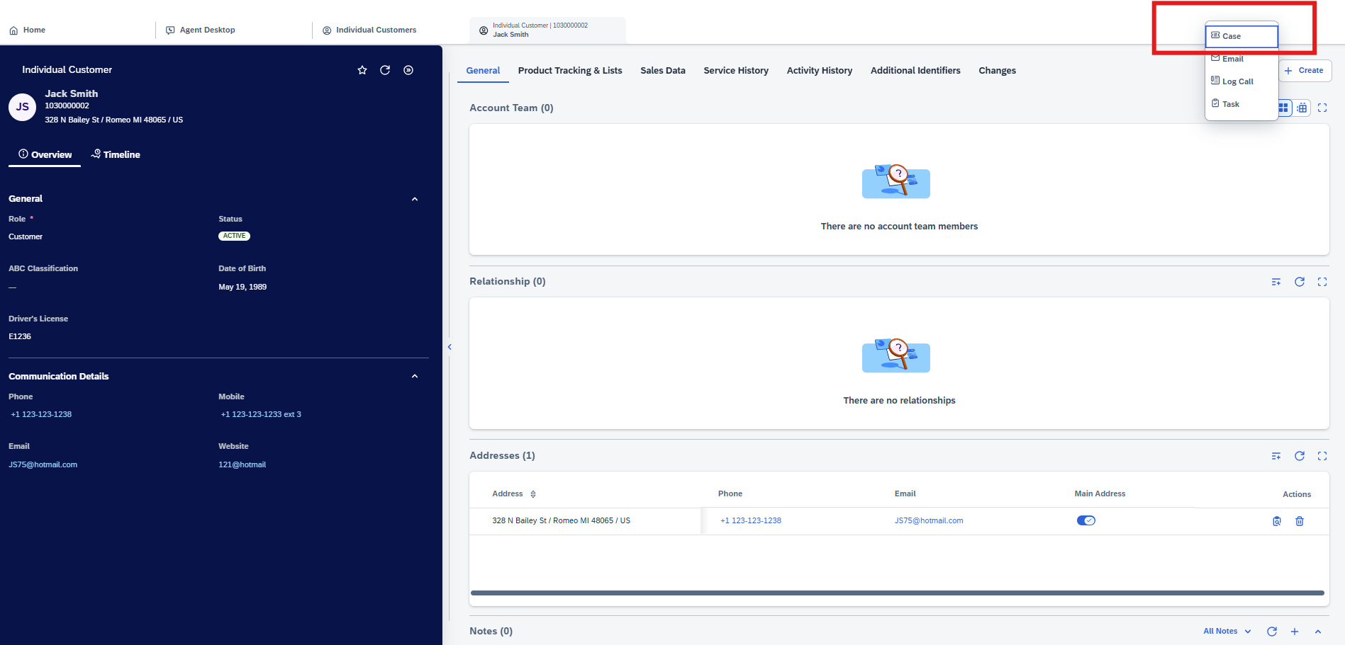
Create Case in Service Cloud v2

Slide 34
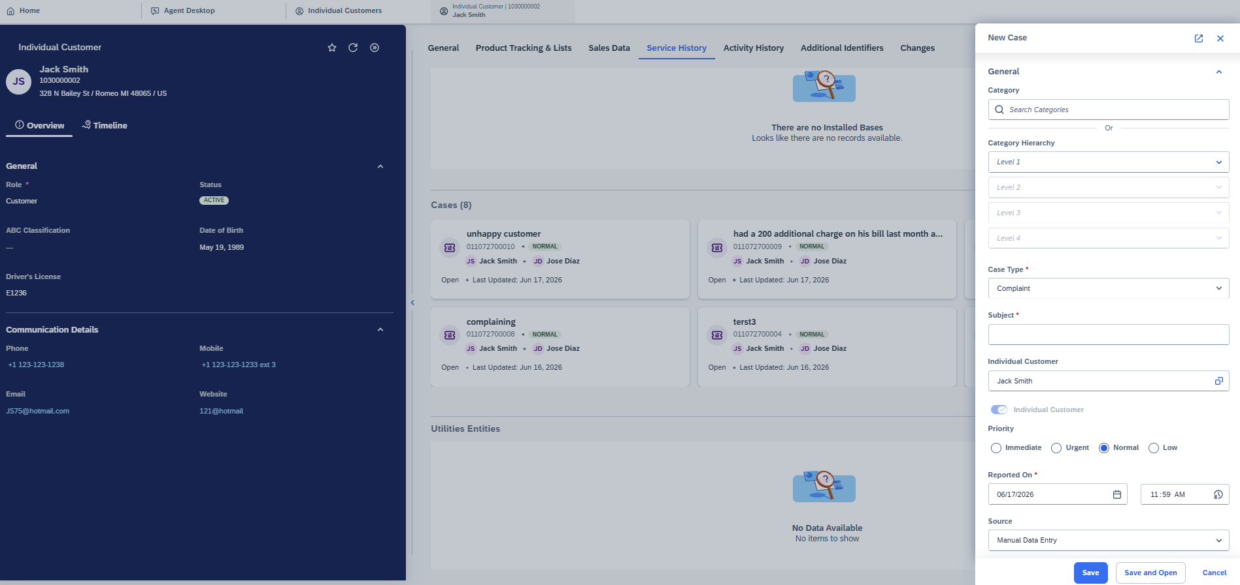
Create Case in Service Cloud v2

Slide 35
02.2 (L3) Display Cases

Slide 36
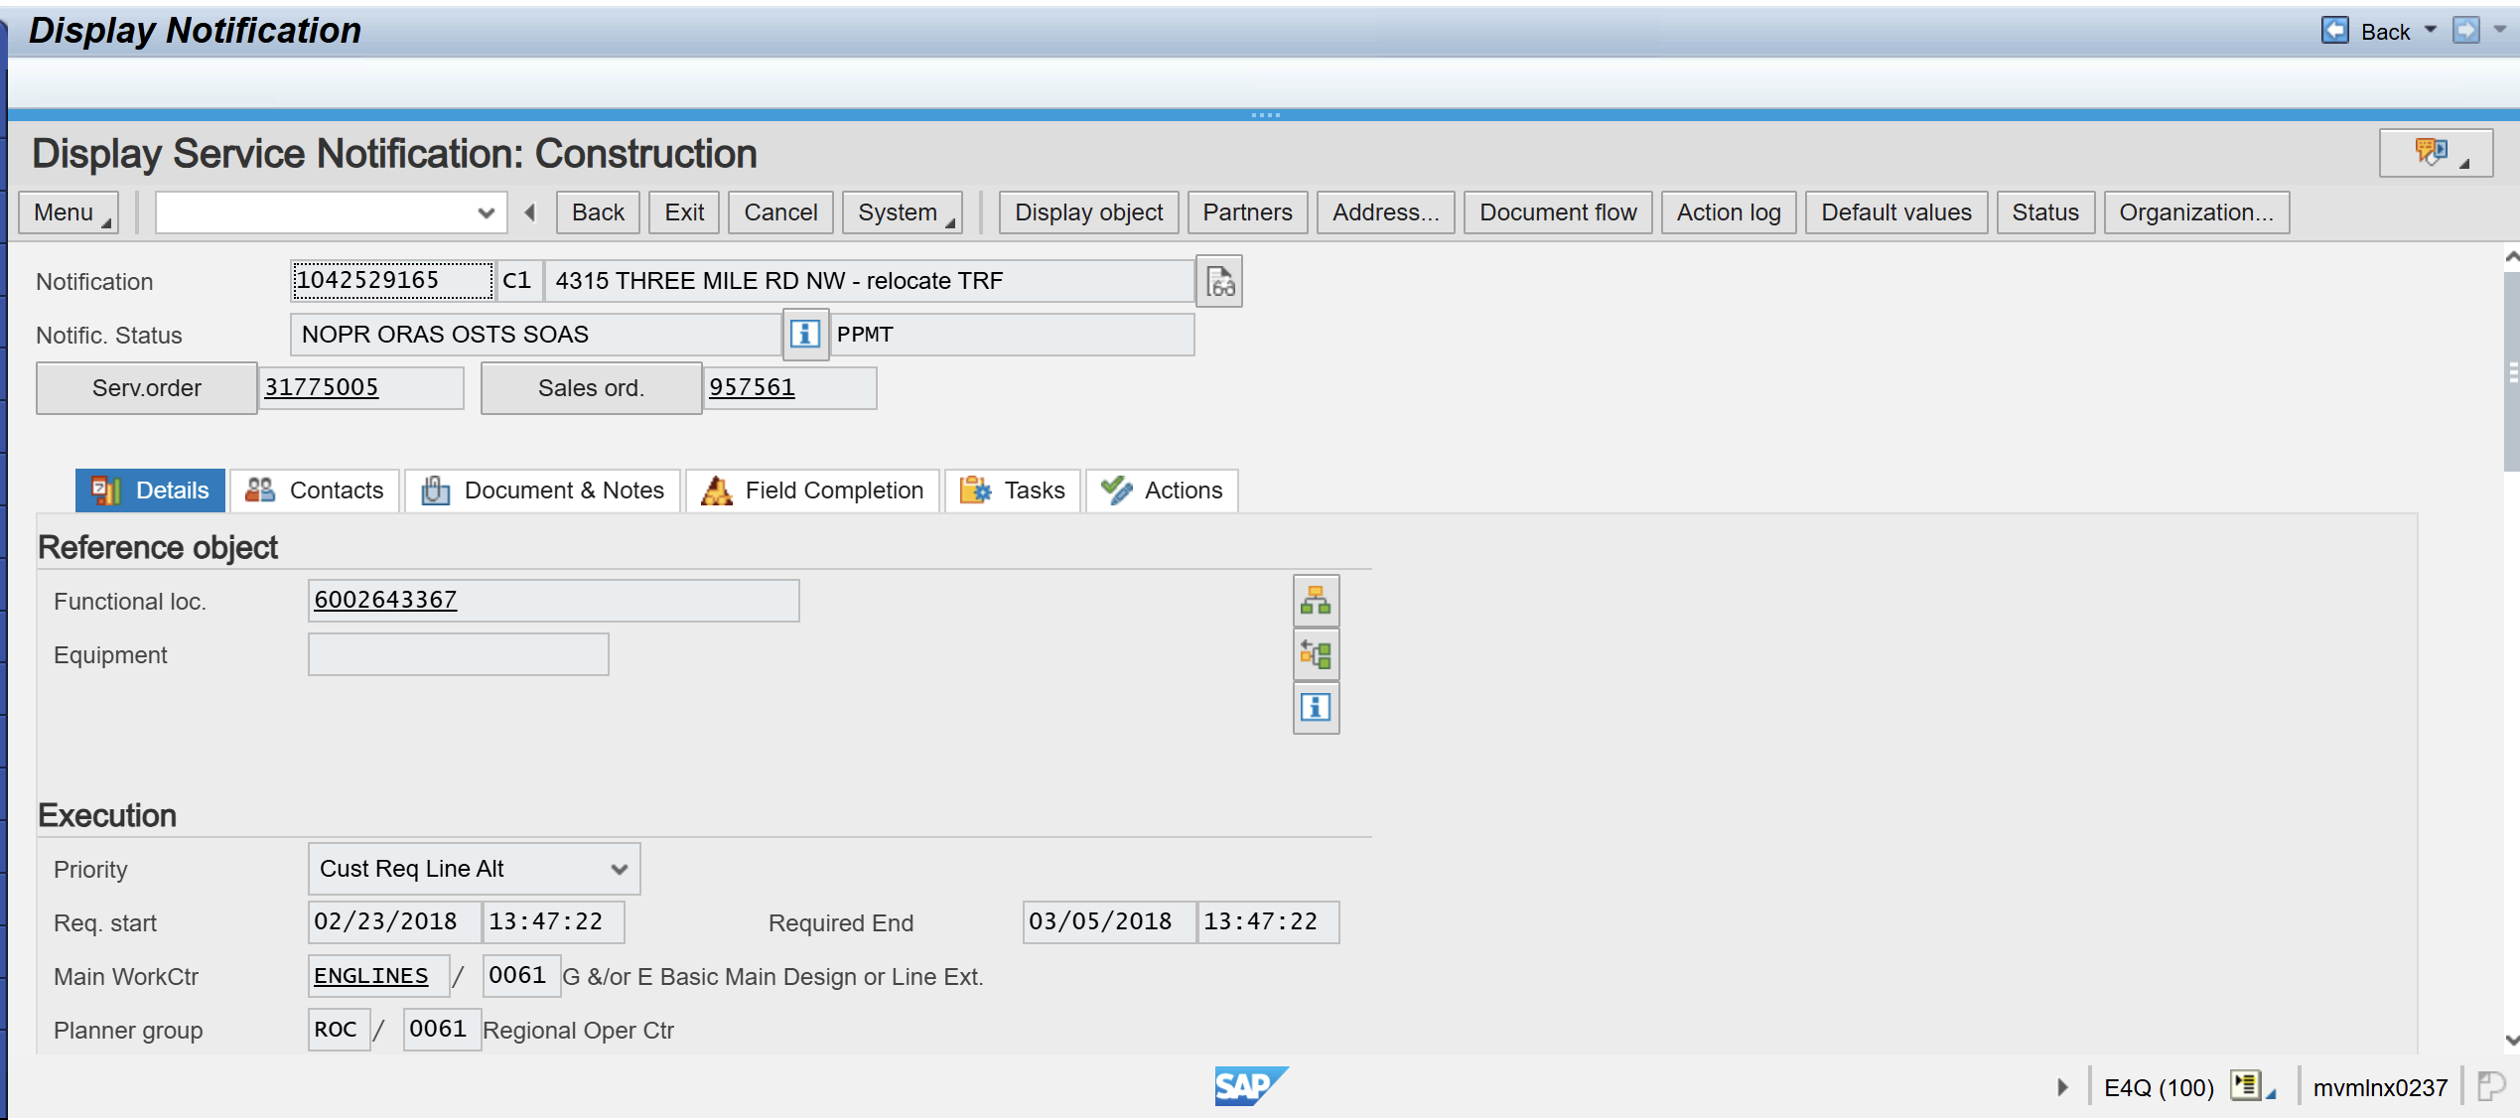
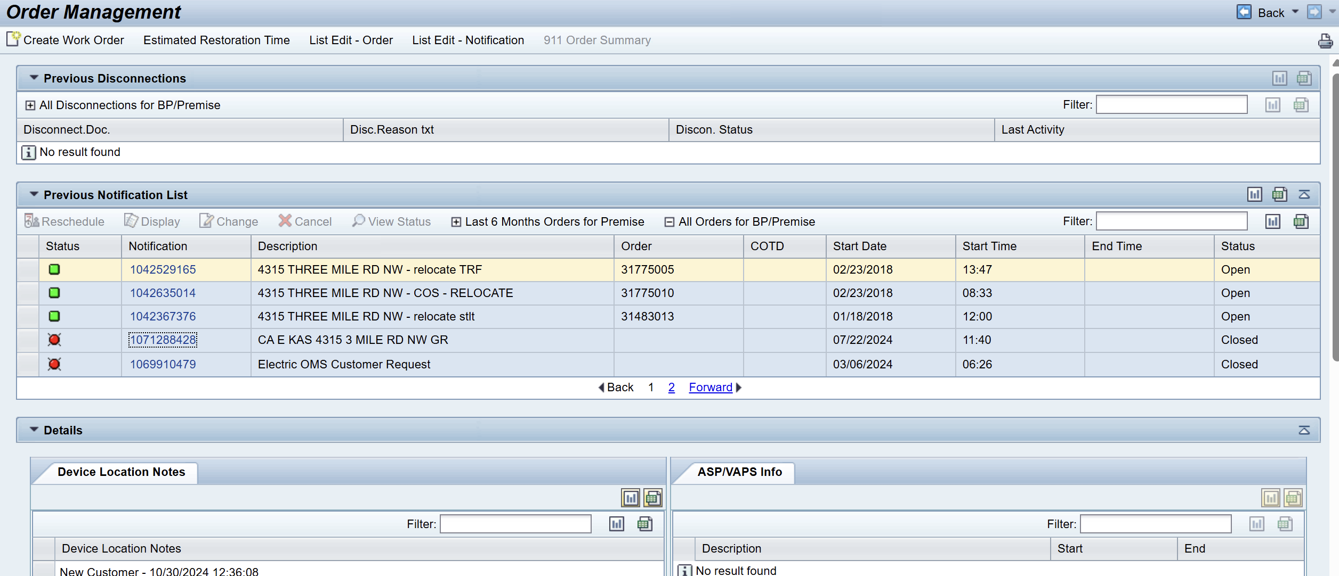
Display Notification

Slide 37
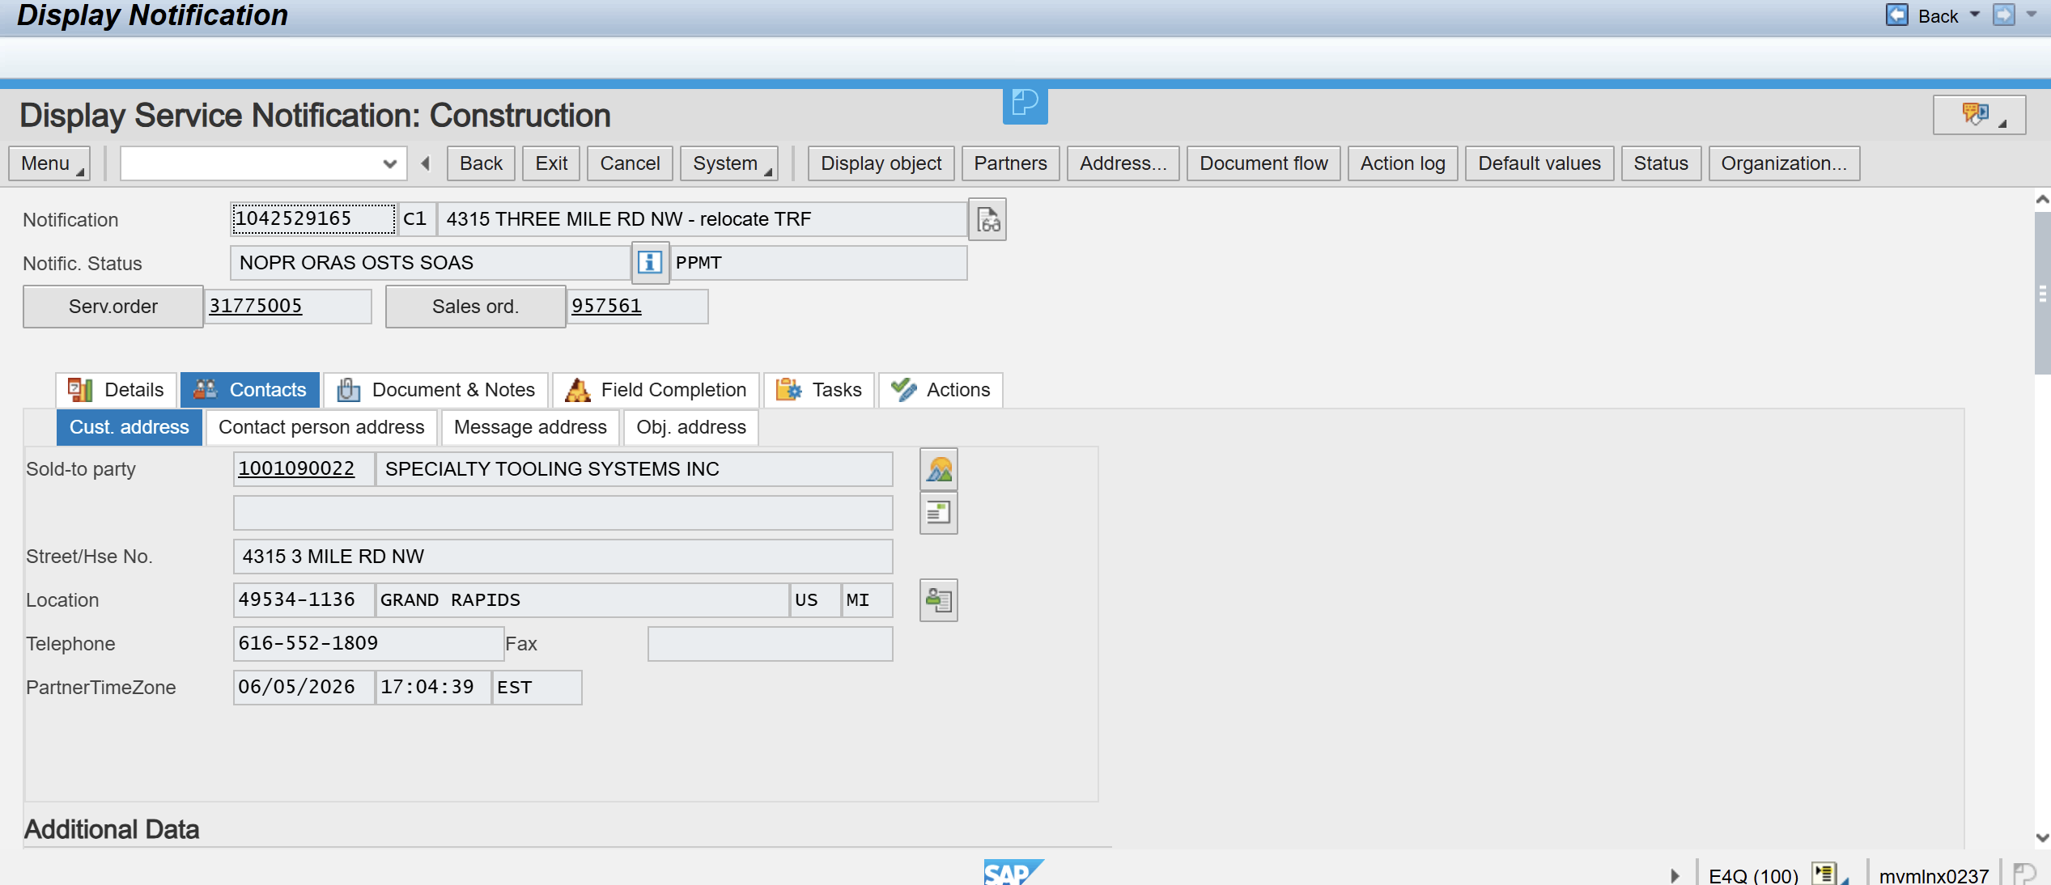
Display Notification: Construction Contacts

Slide 38
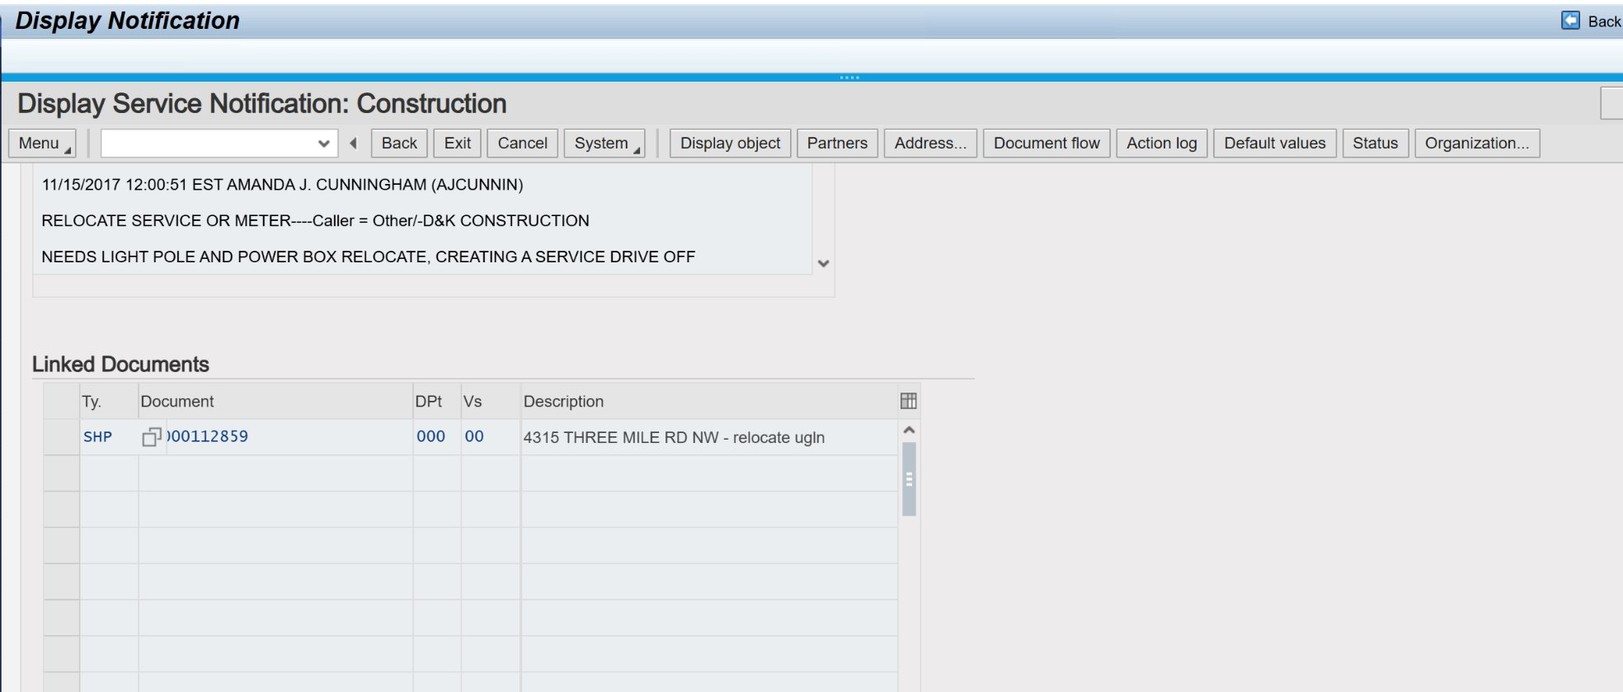
Display Notification: Construction
Document and Notes

Slide 39
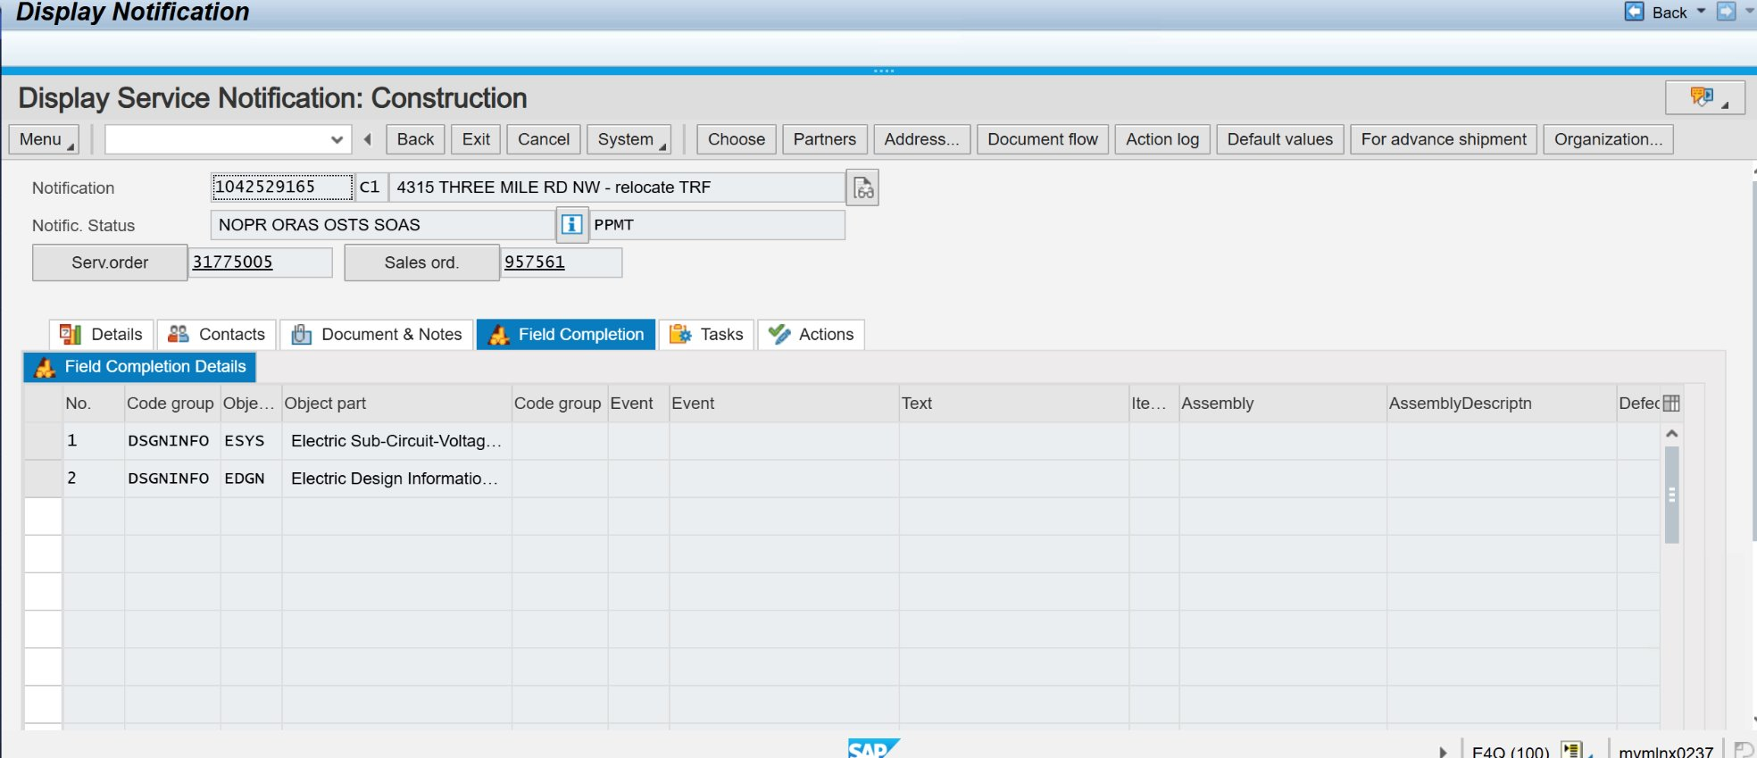
Display Notification: Construction
Field Completion

Slide 40
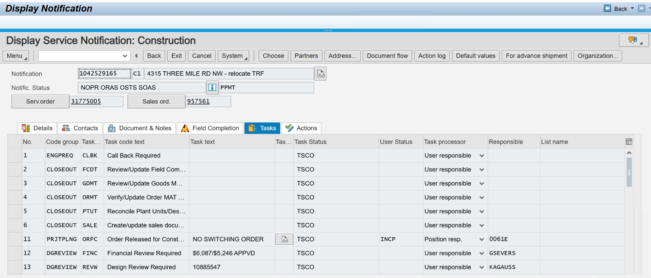
Display Notification: Construction Tasks

Slide 41
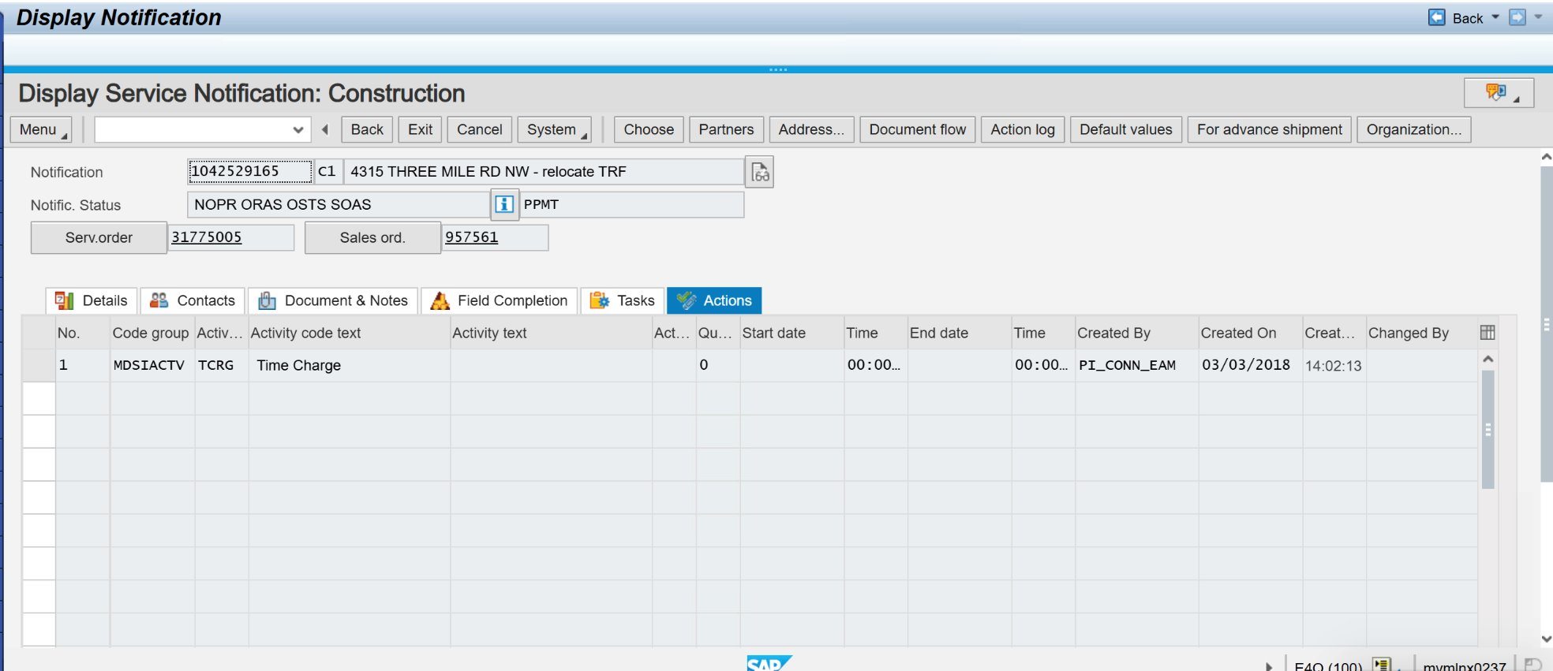
Display Notification: Construction Actions

Slide 42
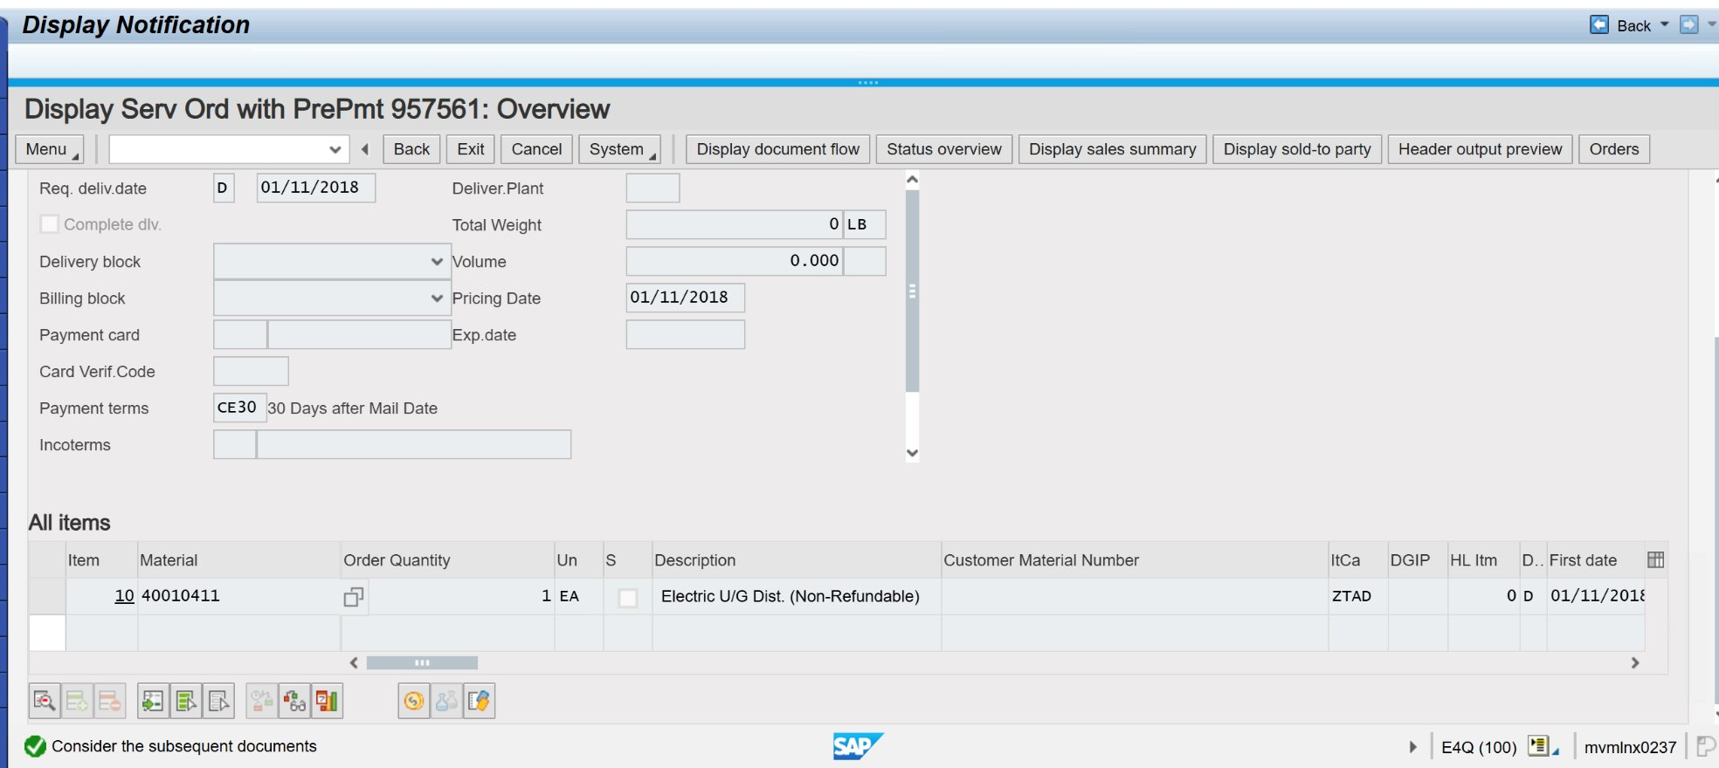
Display Service Order

Slide 43
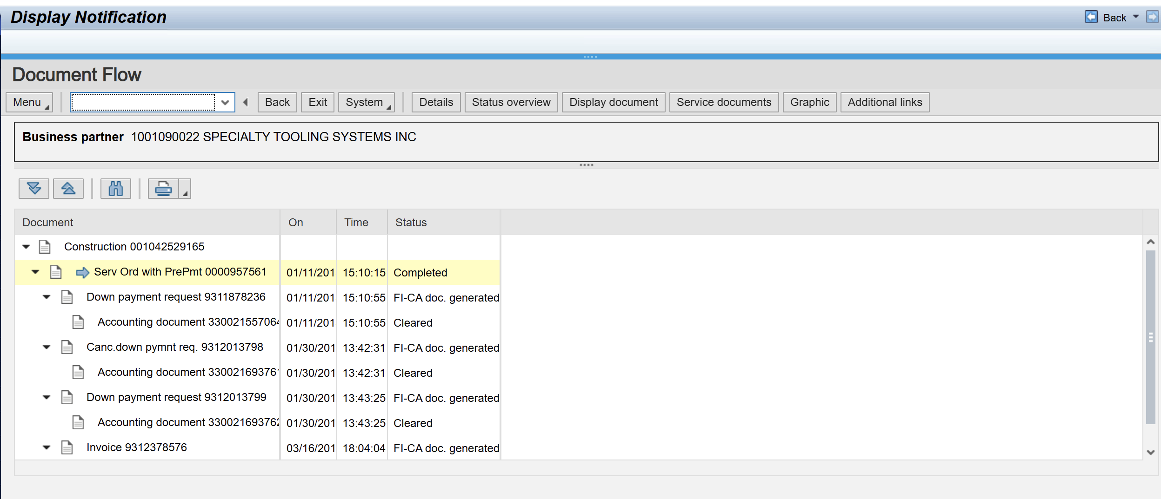
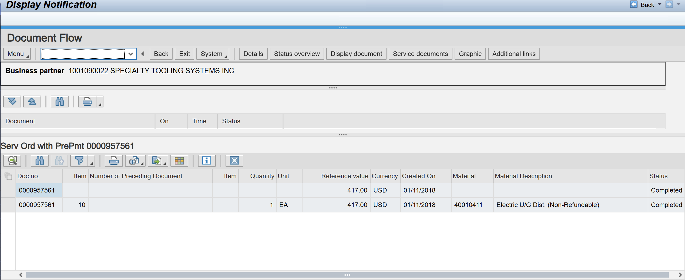
Display Document Flow

Slide 44
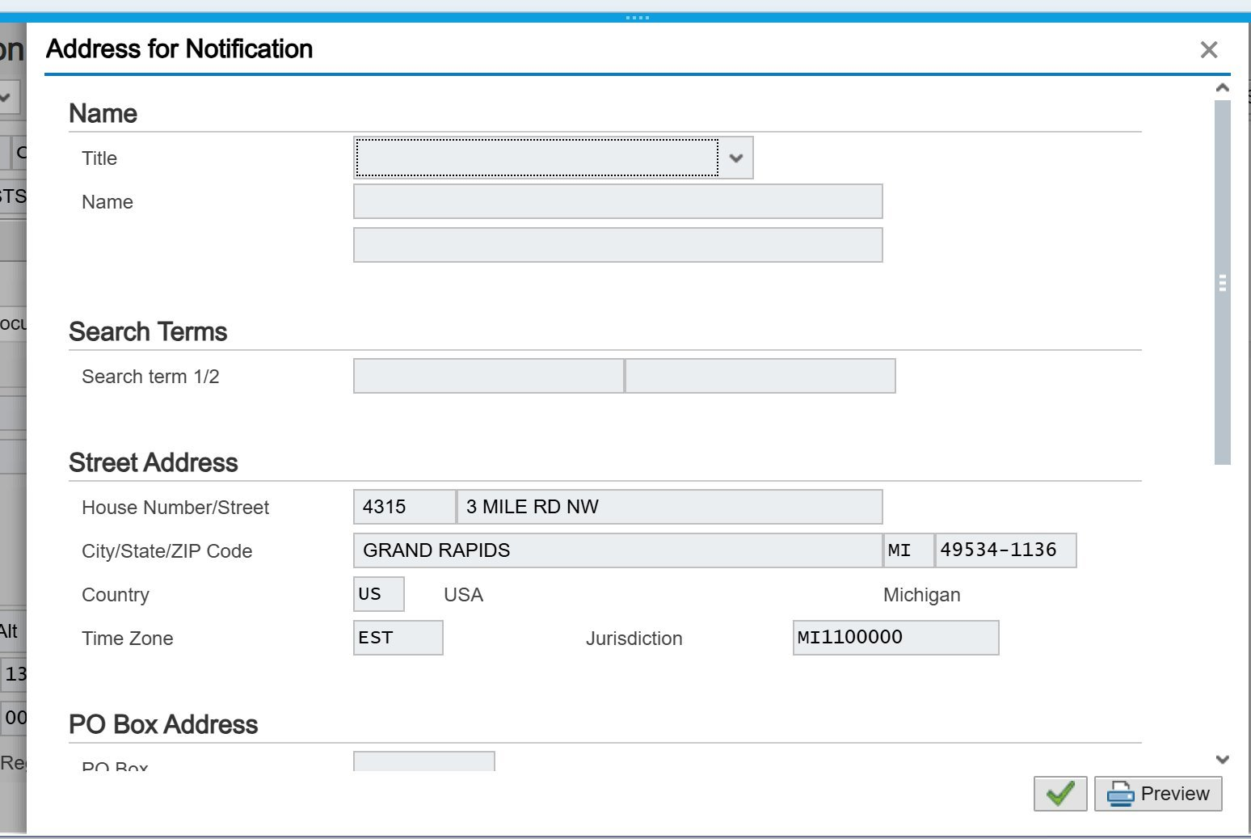
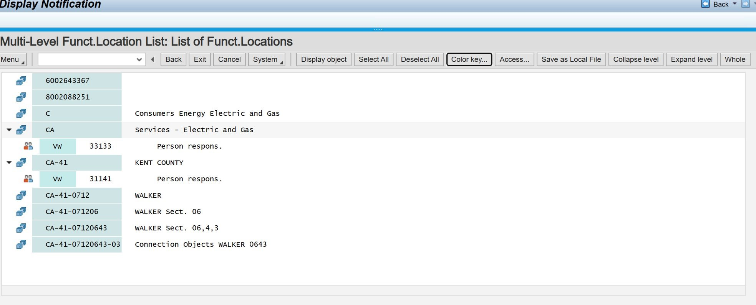
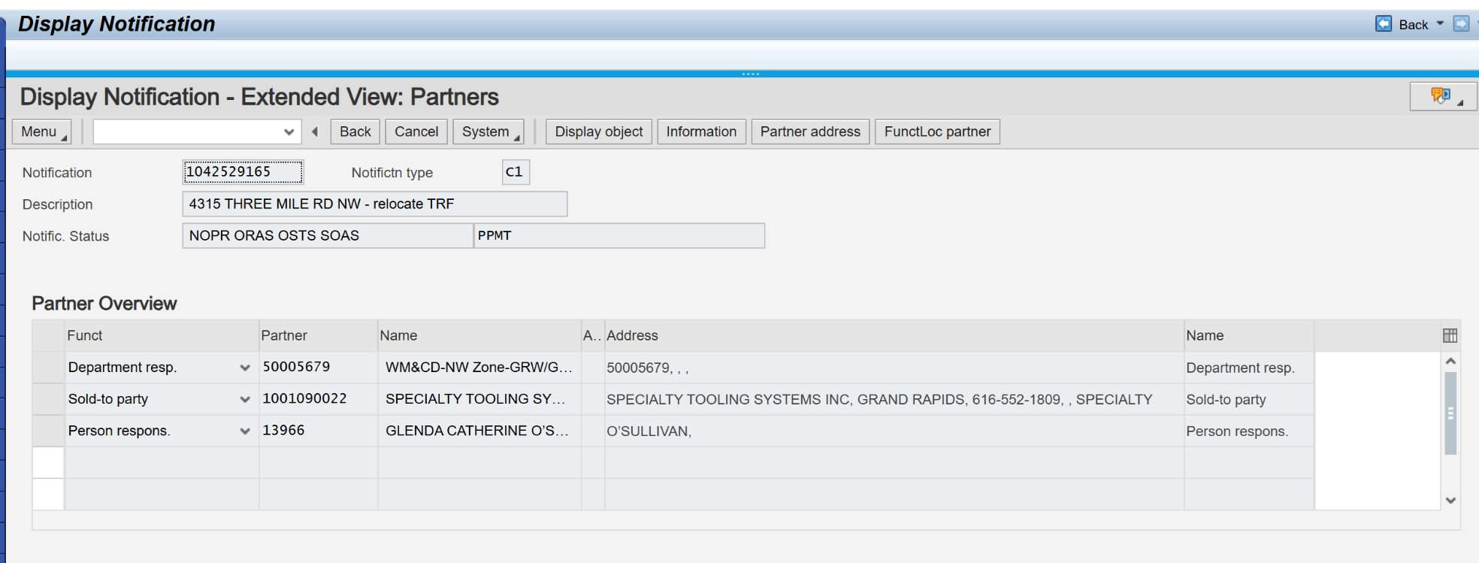
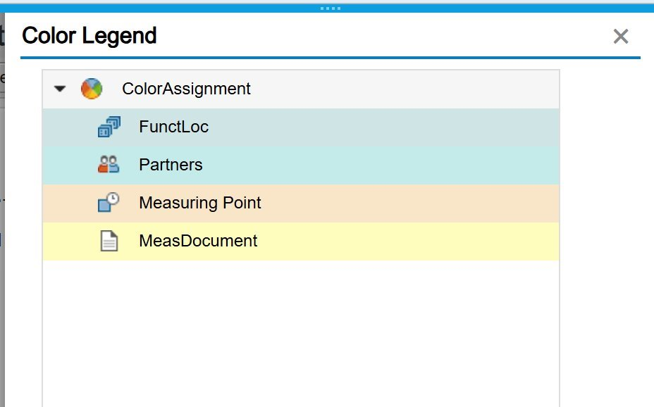
Extended views: Partners, Address, FuntLoc Partner

Slide 45
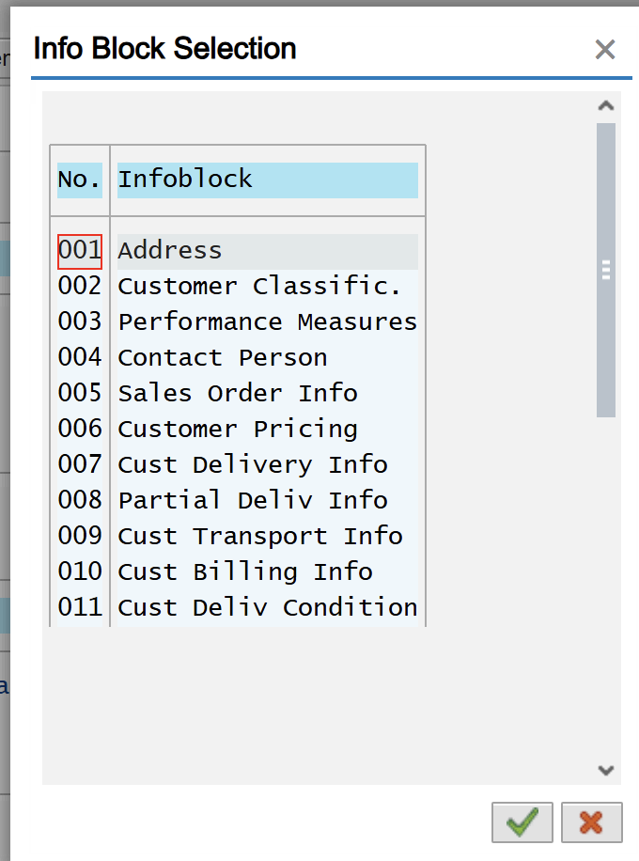
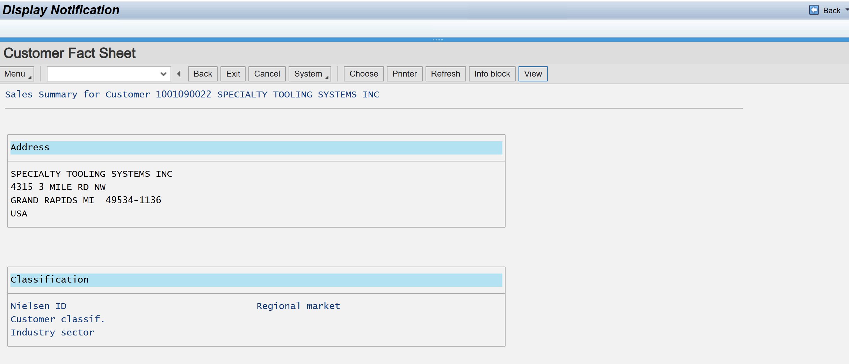
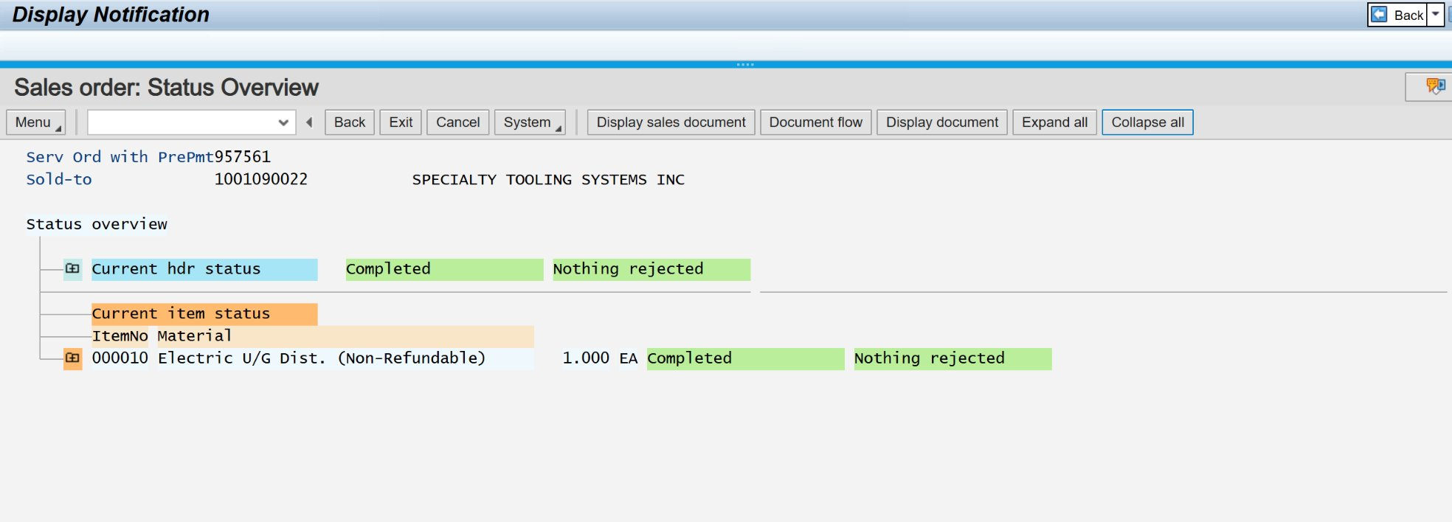
Status Overview, Sales Summary

Slide 46
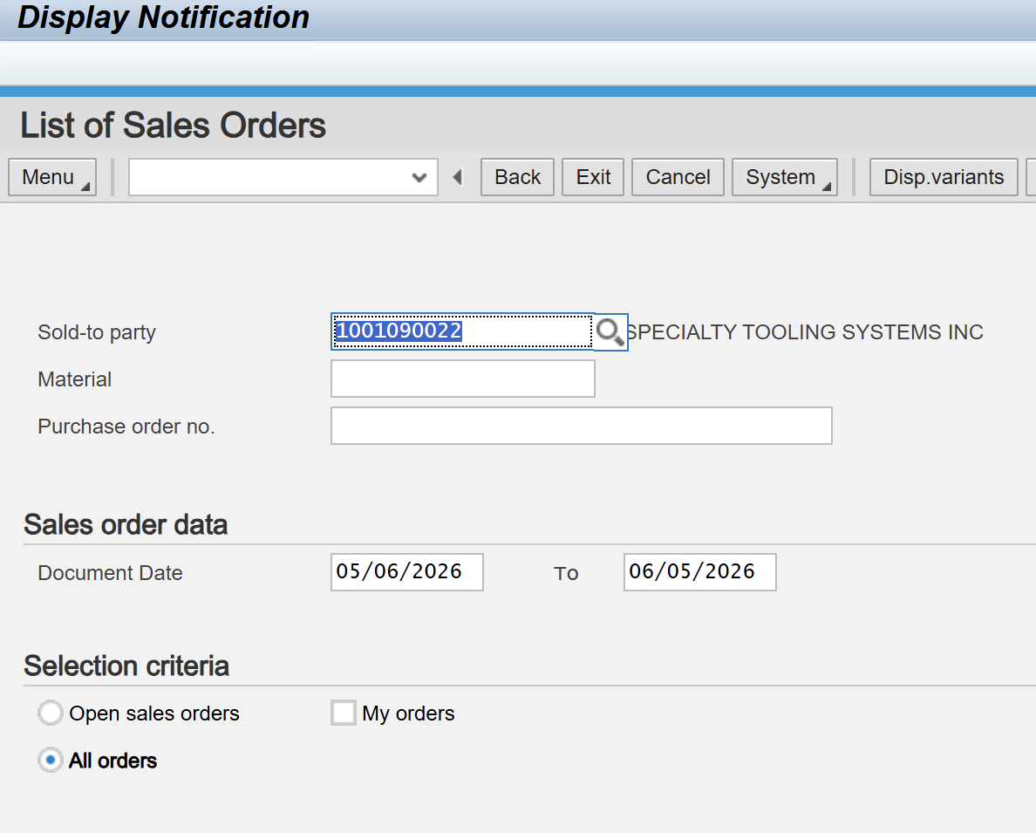
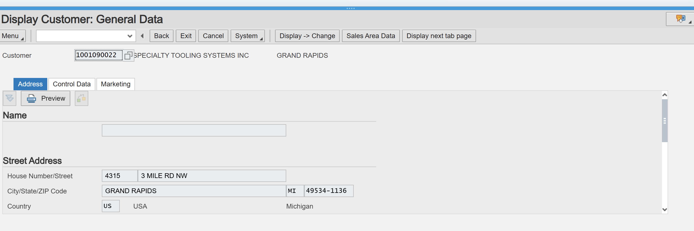
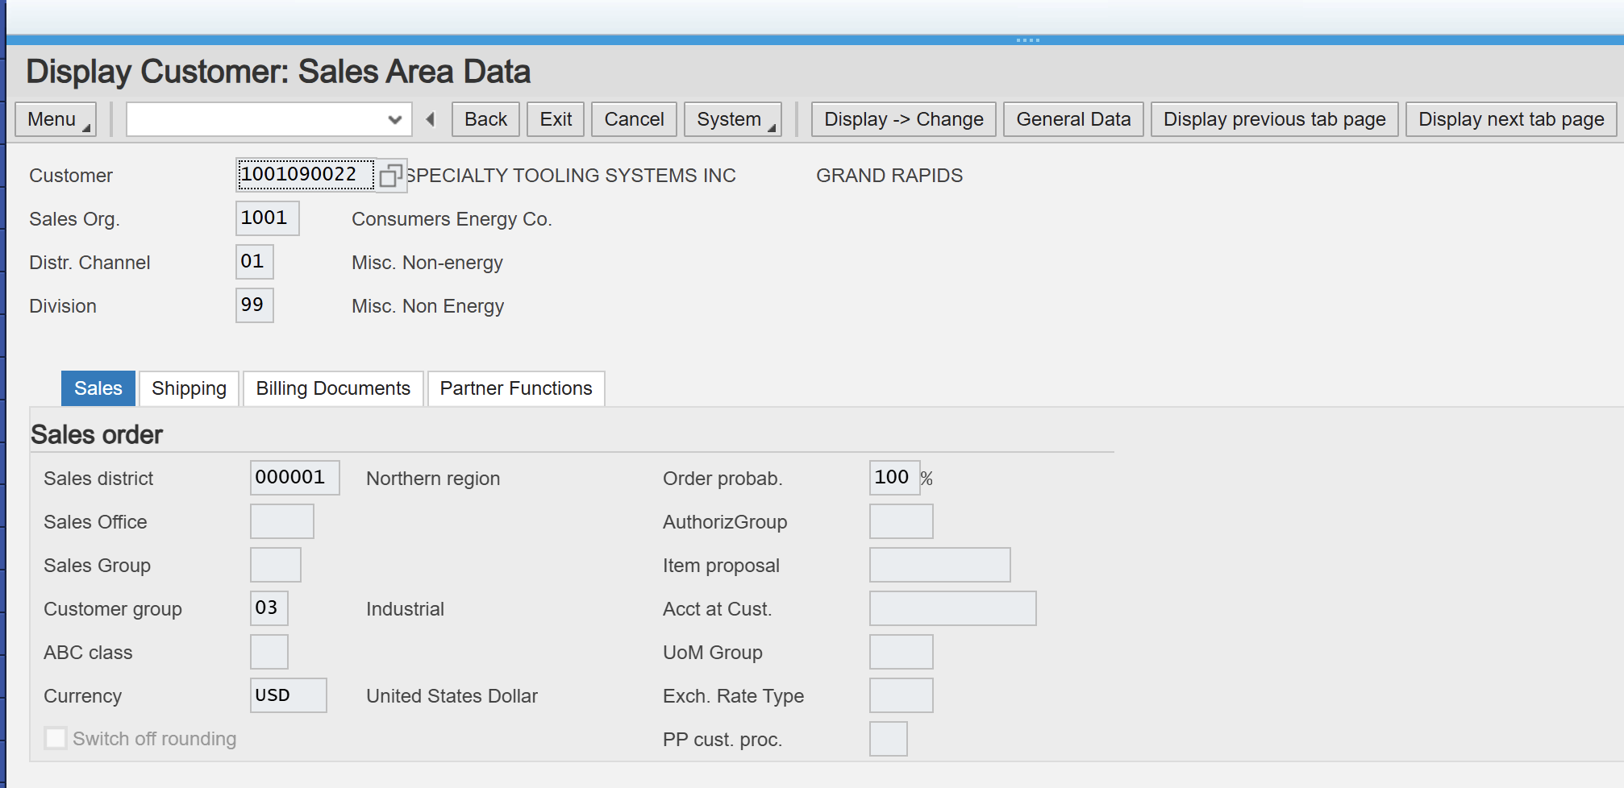
Display Sold To Party & Orders

Slide 47
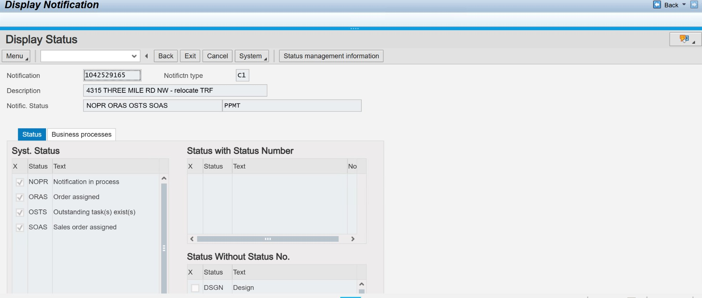
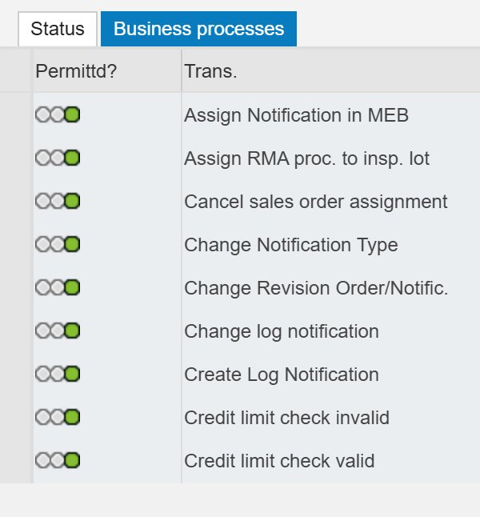
Display Status

Slide 48
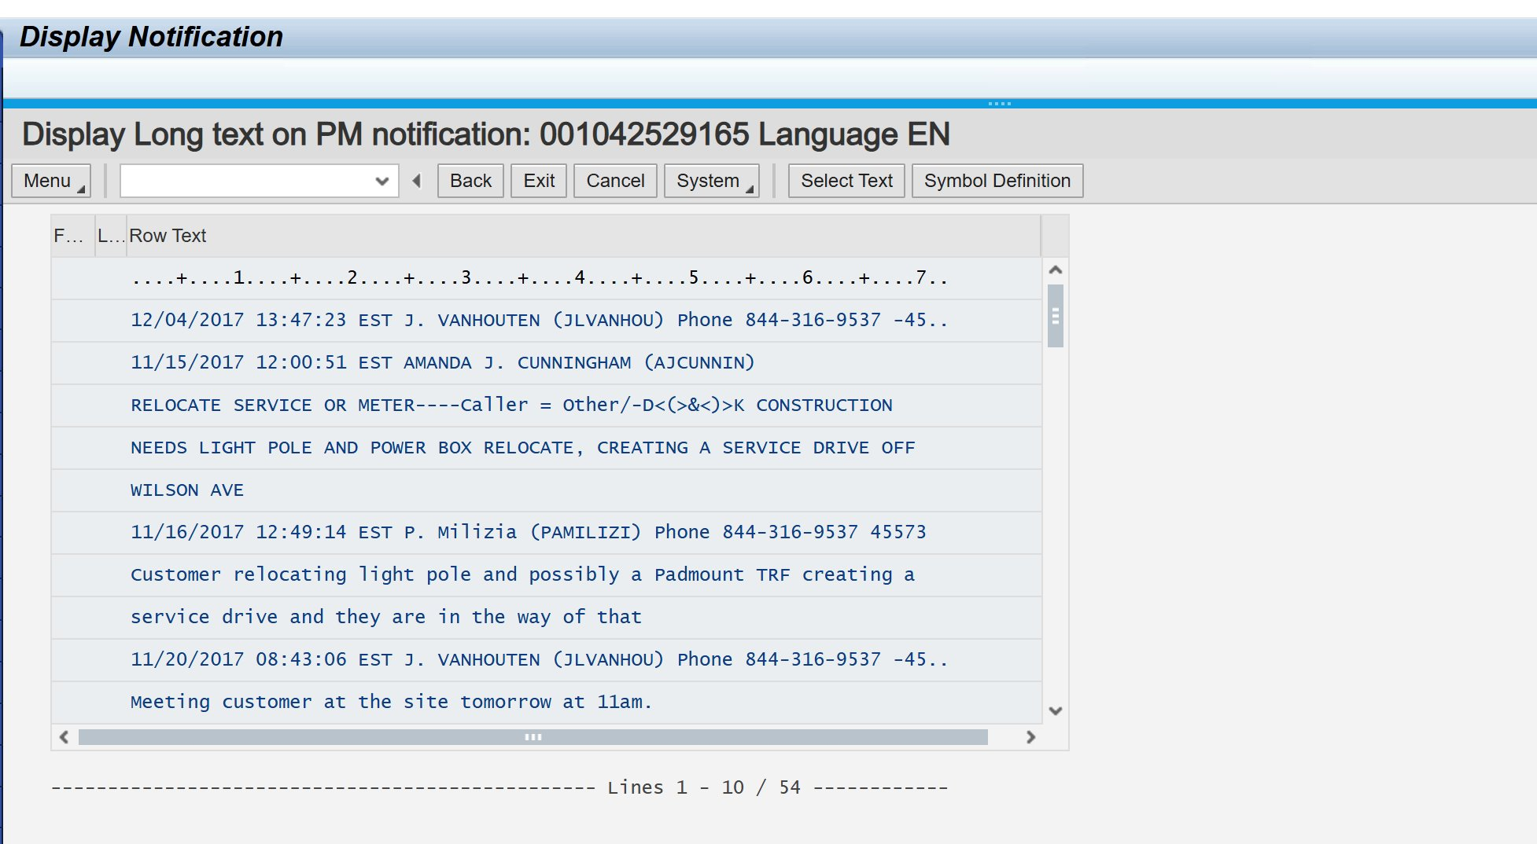
Display Long Text

Slide 49
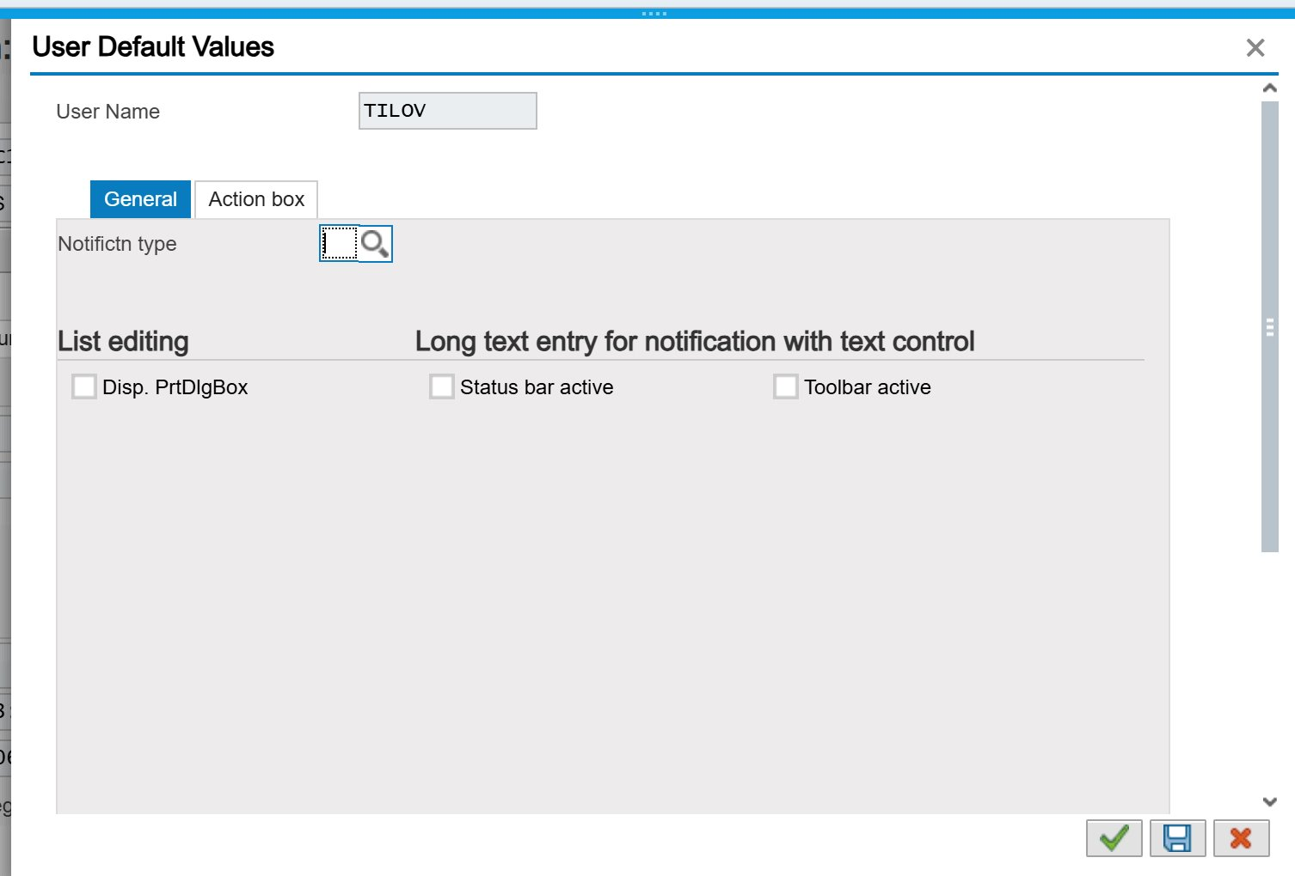

Slide 50
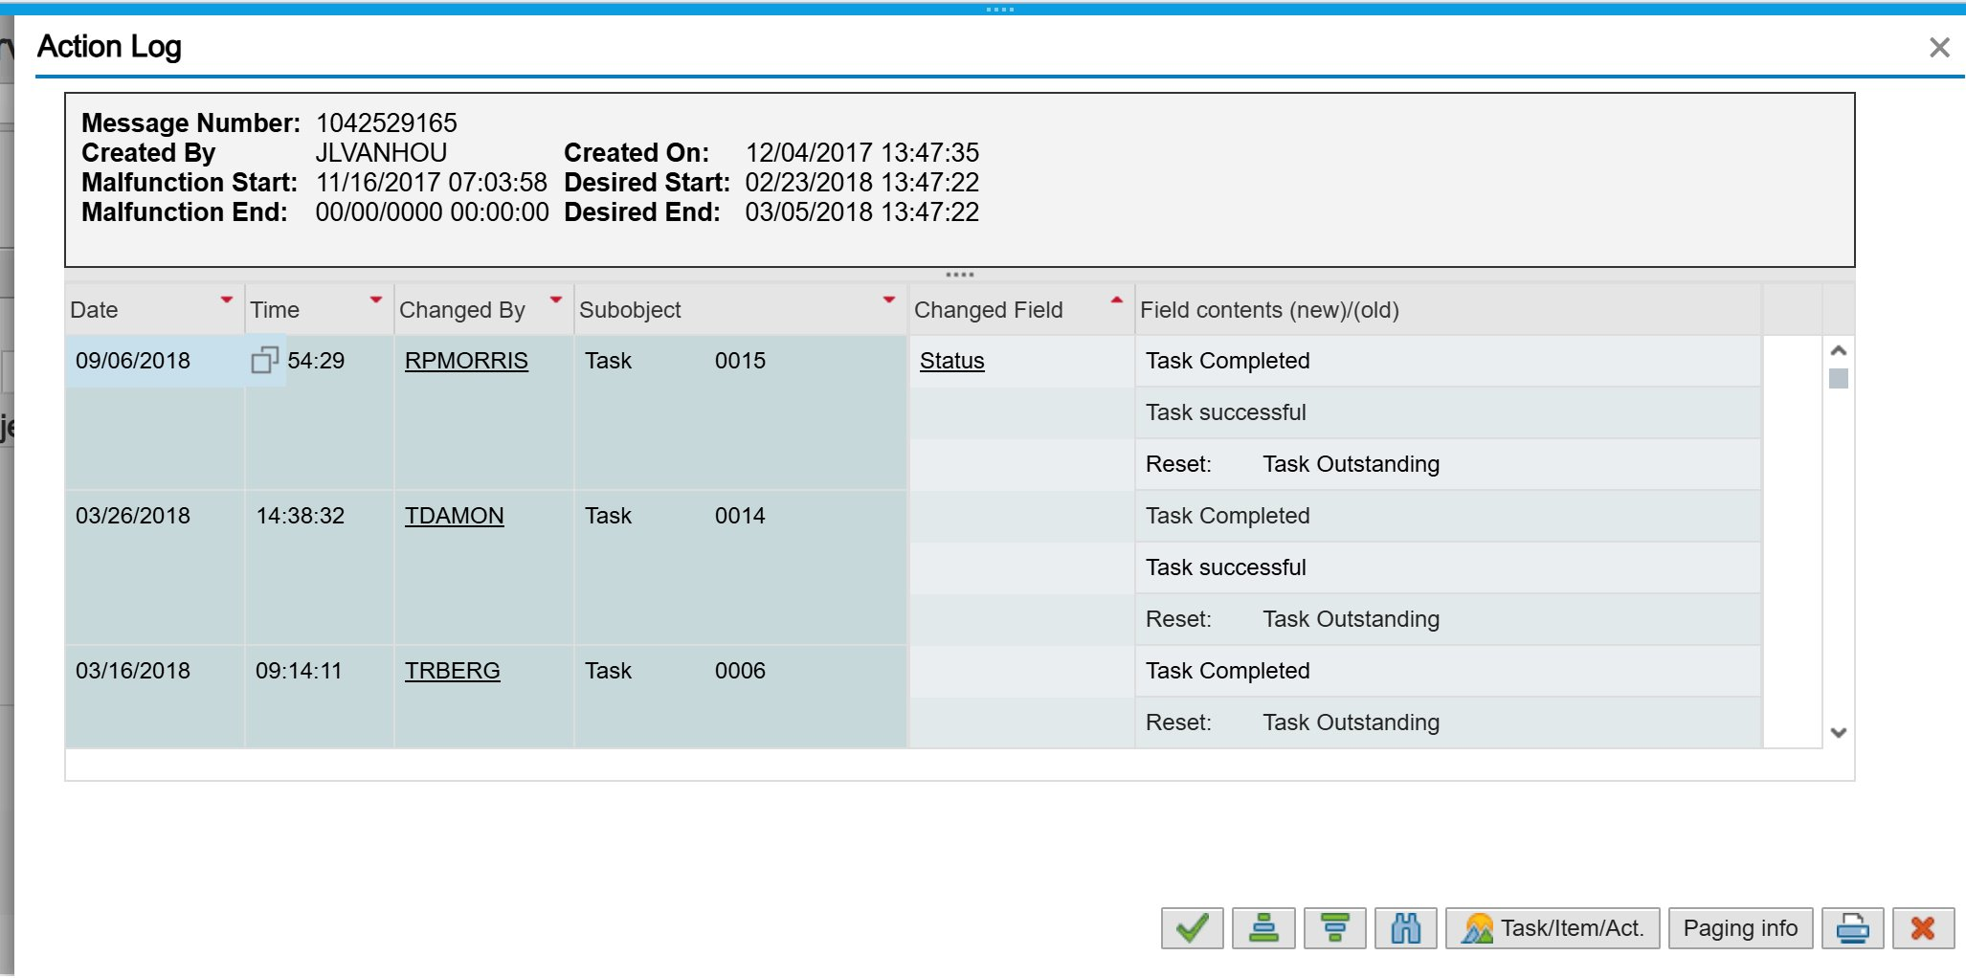

Slide 51
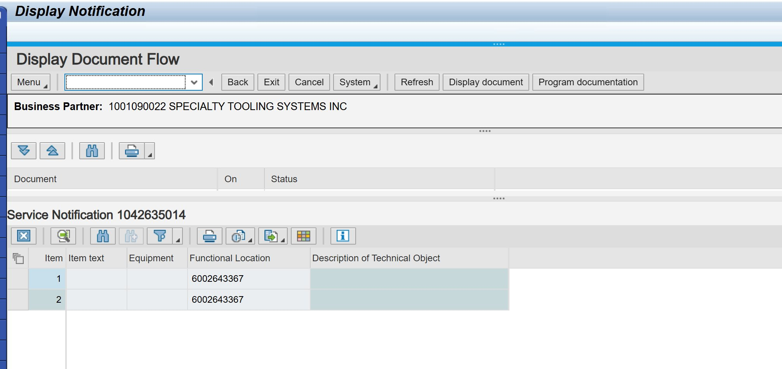
Display Document Flow

Slide 52
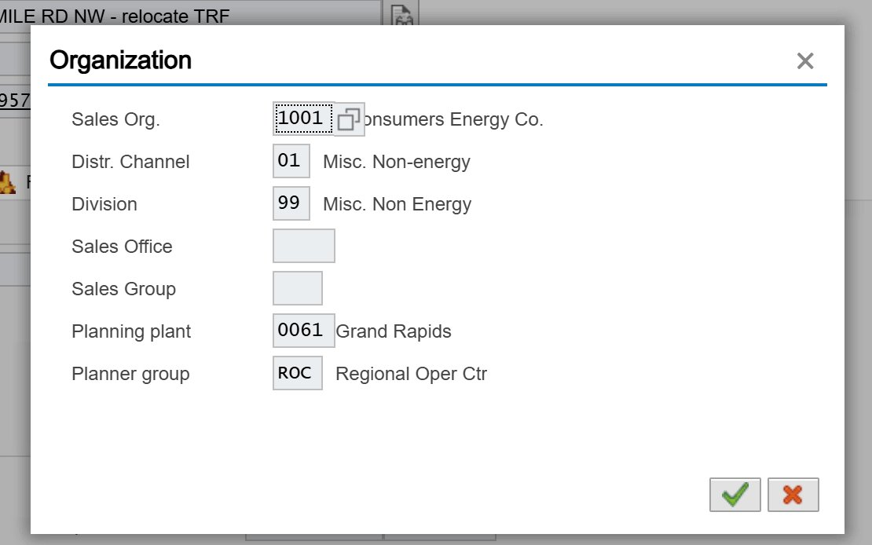

Slide 53
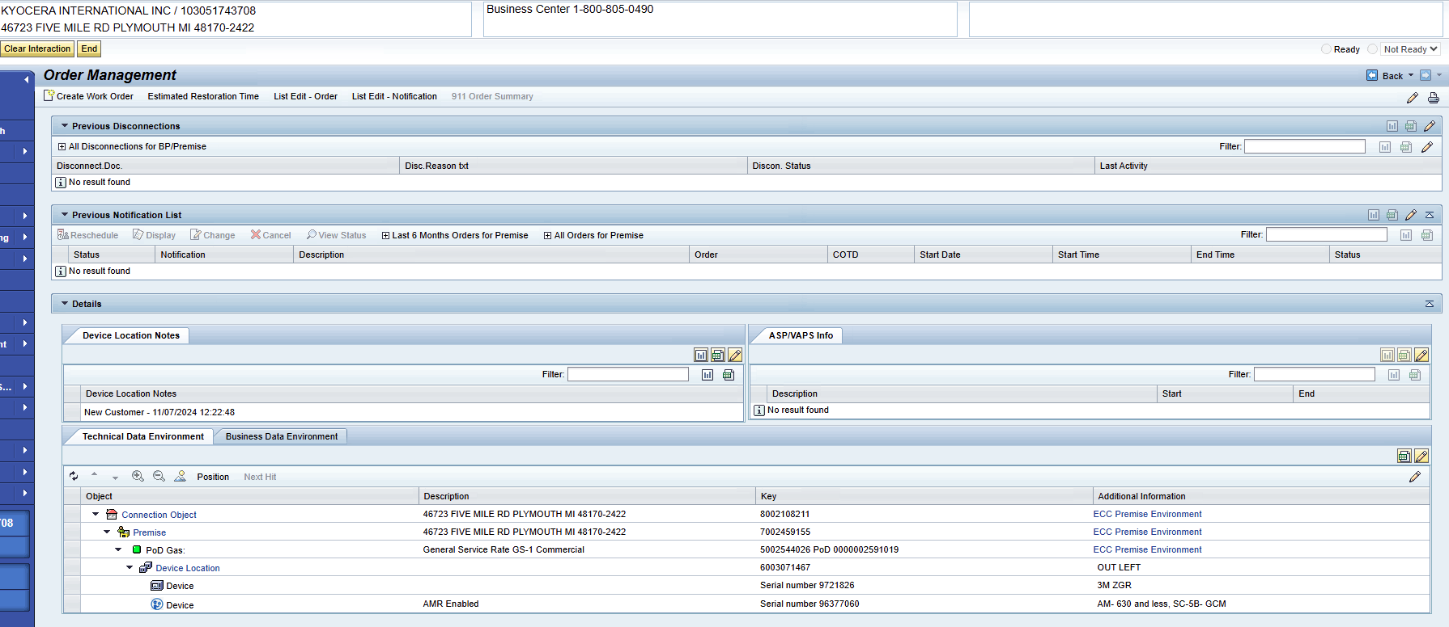
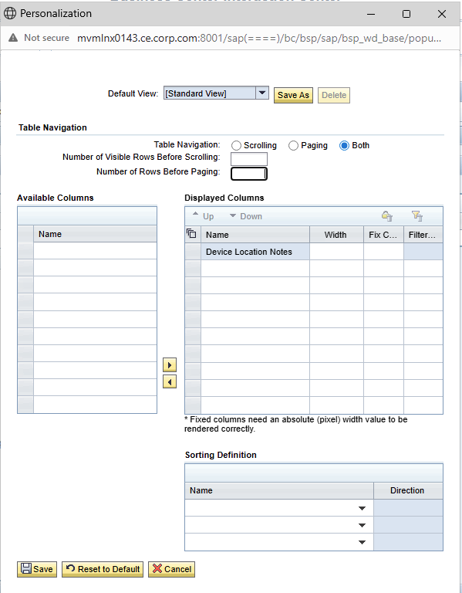
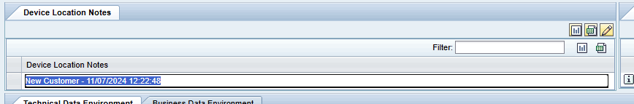
Manage Cases - CRM7
Move to Order Management Deck?

Slide 54
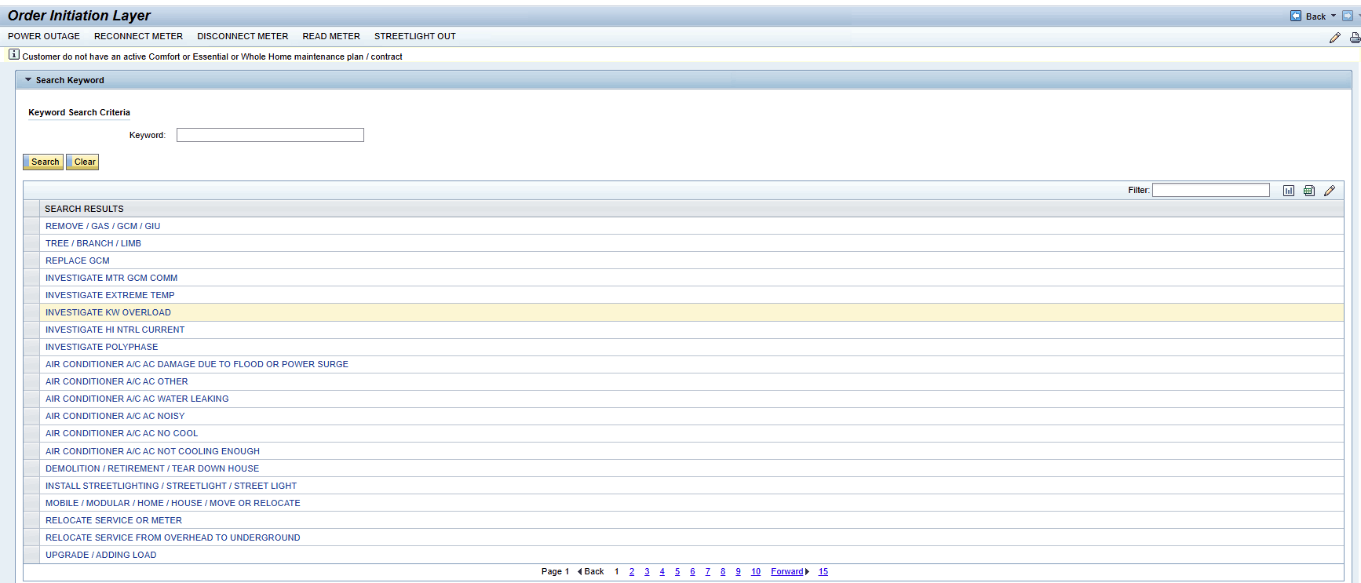
Create Work Order - CRM7
Move to Order Management Deck?
Create Work Order takes you to the Order Initiation Layer. You can enter in the blank keyword to get 15 pages worth of Keyword Results
Options are Power Outage, Reconnect Meter, Disconnect Meter, Read Meter, Streetlight Out

Slide 55
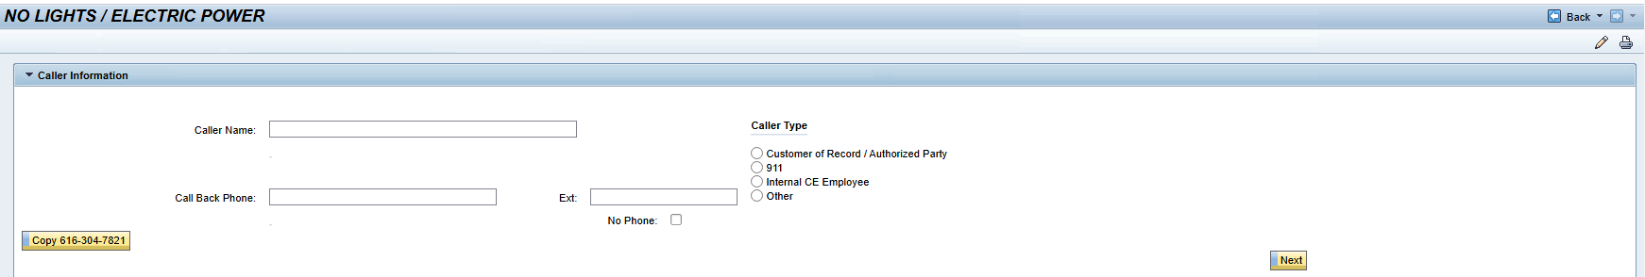



Order Initiation Layer Screens
Move to Order Management Deck?
Power Outage, Reconnect Meter, Disconnect Meter, Read Meter, Streetlight Out all contain the same fields as shown in the larger screenshot

Slide 56


Display Service Notifications
Move to Order Management Deck?

Slide 57

Display Service Notifications

Slide 58


Display Service Notifications
The Multiple Selection for Variant, Environment, Created by, Changed by, and Original Language, all have the same field options as shown below

Slide 59

Display Service Notifications

Slide 60



Display Service Notifications

Slide 61

Display Service Notifications​

Slide 62

Display Service Notifications

Slide 63

Display Service Notifications

Slide 64

Display Service Notifications

Slide 65

Display Service Notifications

Slide 66

Display Service Notifications

Slide 67

Display Service Notifications

Slide 68

Display Service Notifications

Slide 69

Display Service Notifications

Slide 70


Display Service Notifications

